Slide 1
Aminoglycoside Collaborative Practice Dosing Protocol
Created by: Andrew Fratoni, PharmD

Slide 2
IV Aminoglycosides
Gentamicin
Tobramycin*
Amikacin*
*Restricted Antibiotics

Slide 3
Aminoglycoside Drug Class Principles
Good bactericidal activity against gram negative organisms
Typically used in combination with other antibiotics, both empirically and definitively, for treating severe infections caused by Pseudomonas aeruginosa and other multidrug-resistance gram negative organisms
Synergistic effect against gram positive pathogens such as Enterococcus spp., which cause infective endocarditis
Used in combination with a beta-lactam or vancomycin

Slide 4
AG Dosing Strategies
High-Dose Extended Interval
Default strategy for all documented/suspected gram-negative infections unless contraindications apply
Optimizes PK and PD parameters and C_{MAX}:MIC for concentration dependent bactericidal activity against gram-negative pathogens
Reduces trough concentration and duration of renal and otic tissue exposure to potentially minimize risk of toxicity without compromising efficacy by taking advantage of the post antibiotic effect
Traditional Dosing
Special-Indication Dosing
Ex – synergistic agent for gram positive infection

Slide 5
Pharmacist Responsibilities
Review and collect the following:
Patient age and gender
Allergy history
Current/most recent height, body weight, and BMI
Contact nurse and/or prescriber to verify any unusual parameters (height < 60 inches, weight < 40 kg or >150 kg)
Current and historical SCr
Documented/Suspected infectious diagnosis

Slide 6
Dosing Weight
Use ACTUAL body weight (ABW) if not >120% IBW
Use ADJUSTED body weight if ABW is >120% IBW
Note: IBW is NOT used for the dosing weight in AGs

Slide 7
Calculate Estimated Creatinine Clearance
Utilize Cockcroft-Gault equation
Male: Est CrCl = (140-age) (Actual Weight**) Female: Est CrCl = (140-age) (Actual Weight**) x 0.85
(72)(SCr) (72)(SCr)
**If actual weight is < IBW, use actual weight; if actual weight is > IBW but < 120% of IBW, use IBW; if actual weight is ≥ 120% IBW, use Adj BW.
NOTE: The selected weight above is used only for determining CrCl and is NOT the dosing weight
For patients >65 yo with SCr <0.8 mg/dL, round SCr to 0.8

Slide 8
Important AG Dosing Considerations
Chronic or Acute Hemodialysis
Current guidelines for gentamicin use in HD patients suggest the dose should be given after HD
Continuous Renal Replacement Therapy (CRRT)
Extent of AG drug removal is directly proportional to the dialyzer surface area and mode of replacement administration, ultra filtration and dialysate flow rate and is therefore variable
Significant Obesity: BMI >35, ABW >40% of IBW
40% dosing weight correction factor seems to remain accurate in morbidly obese patients, even with extended interval AG dosing
Acute Changing Renal Function (SCr ↑or↓ >0.5 mg/dL in 24hrs)
Obtain 1 random level and hold further doses for sudden SCr ↑
Obtain SCr at baseline and at least every 2 days while on AG therapy, or daily with baseline renal insufficiency, severe infection/sepsis, or concomitant use with other nephrotoxic drugs

Slide 9
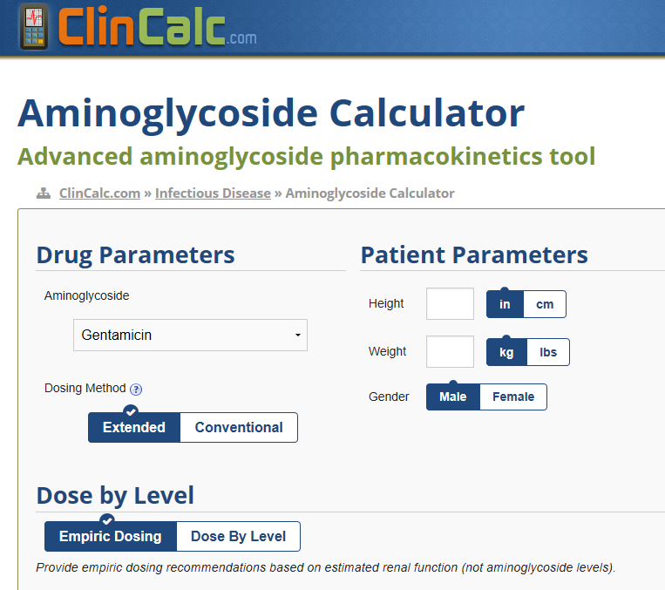
Aminoglycoside Dosing Calculators
An internet-based clinical calculator such as Clincalc.com® or GlobalRPh.com® may be utilized to more specifically determine dose and frequency based on levels and patient factors

Slide 10
4 I-Vents for Documentation
Aminoglycoside High Dose Extended Interval
Initial Note
Daily Monitoring Note (also to be used as follow-up to address lab values and dosing changes)
Aminoglycoside Traditional or Gram Positive Synergy
Initial Note
Daily Monitoring Note (also to be used as follow-up to address lab values and dosing changes)
All Initial Notes, as well as Daily Monitoring Notes that address a drug level or change in AG dose/frequency, must be copied and signed as an official note in the patient’s chart

Slide 11
High-Dose Extended Interval

Slide 12
High-Dose Extended Interval
STEP 1: Determine if patient meets any contraindications for this dosing strategy:
Dialysis
Estimated CrCl < 20 mL/min
Unstable renal function with worsening renal function prior to or during therapy (50% increase in SCr from baseline)
Ascites, severe liver disease, or excessive third spacing of fluids
Pregnancy
Burns (>20% BSA)
Cystic Fibrosis
Use of AG as a synergistic agent for a gram positive infection

Slide 13
High-Dose Extended Interval
STEP 2: Determine dosing weight*
STEP 3: Calculate estimated CrCl*
*Refer to previous slides for guidance

Slide 14
High-Dose Extended Interval
STEP 4: Determine Dose and Interval
Est CrCl (ml/min) | Gentamicin or Tobramycin | Amikacin
> 60 | 7 mg/kg IV q24h | 15 mg/kg IV q24h
40-59 | 7 mg/kg IV q36h | 15 mg/kg IV q36h
20-39 | 7 mg/kg IV q48h | 15 mg/kg IV q48h
< 20 | Use Traditional Dosing | Use Traditional Dosing

Slide 15
High-Dose Extended Interval
STEP 5: Obtain Lab Values for Therapeutic Monitoring
Obtain one RANDOM serum level 6-12 hrs after the start of the FIRST infusion
After initial level, obtain one random serum level every 3-5 days to ensure dosing interval is still appropriate

Slide 16
High-Dose Extended Interval
STEP 6: Interpret AG Serum Levels
Use the Hartford Nomogram to determine dosing interval appropriateness

Slide 17
High-Dose Extended Interval
Hartford Nomogram Pearls:
For amikacin, divide the level in half before plotting on nomogram
If the random level falls within an area, use the indicated interval
If the random level falls on a line, use the longer dosing interval
If the random level falls above the Q48H line, discontinue the current dosing regimen. To continue with gentamicin/tobramycin wait until the level is < 1 mg/L and then use traditional dose. For amikacin, wait until the level is < 5mg/L and then use traditional dosing

Slide 18
High-Dose Extended Interval I-Vent Initial Note

Slide 19
High-Dose Extended Interval I-Vent Daily Monitoring Note

Slide 20
Traditional Dosing

Slide 21
Traditional Dosing
STEP 1: Determine dosing weight*
STEP 2: Calculate estimated CrCl*
*Refer to previous slides for guidance

Slide 22
Traditional Dosing
STEP 3: Determine Aminoglycoside Dose
Aminoglycoside | Loading Dose | Maintenance Dose
Gentamicin/Tobramycin | 2 mg/kg | 1.7 mg/kg
Amikacin | 7.5 mg/kg | 7.5 mg/kg

Slide 23
Traditional Dosing
STEP 4: Determine Dose Frequency
**An internet-based clinical calculator (i.e. Clinicalc® or GlobapRPH®) may be utilized to more specifically determine the aminoglycoside dose and interval frequency based on patient factors (age, weight, creatinine, etc). NOTE: The usual range of volume of distribution for aminoglycosides is 0.25 - 0.35 L/kg
Est CrCl (ml/min) | Interval
> 50 | q8h
10-50 | q12-48h**
<10 | q48-72h**
Hemodialysis | post-dialysis

Slide 24
Traditional Dosing
STEP 5: Obtain Lab Values for Therapeutic Monitoring
Obtain TROUGH level immediately before 3rd maintenance dose
Obtain PEAK level 30 mins after the end of infusion of 3rd maintenance dose
After initial peak and trough, obtain peakand trough levels every 3-5 days to ensure dose and interval are still appropriate
For renal failure and CVVH, obtain levels daily and re-dose when levels fall to desired troughs

Slide 25
Traditional Dosing
STEP 6: Interpret Aminoglycoside Serum Levels
Interpret peak and trough levels based on indication
Infection Type | Desired Peak Level |  | Desired Trough Level
 | Gentamicin/Tobramycin | Amikacin | Gentamicin/Tobramycin | Amikacin
Pneumonia, Documented Pseudomonal Infections | 7-10 | 30-35 | <1 | <5
Non-Pseudomonal Gram Negative Infection | 5-7 | 20-30 | <1 | <5
Gram Positive Synergy (Gentamicin only), UTIs | 3-4 | N/A | <1 | N/A

Slide 26
Traditional Dosing
STEP 6: Interpret Aminoglycoside Serum Levels
Adjust AG dose based on the peak and trough obtained
Peak | Trough | Recommended Change
> desired range | > desired range | decrease dose and increase dosing interval
> desired range | within desired range | decrease dose
< desired range | > desired range | increase dose and increase dosing interval
< desired range | within desired range | increase dose
within desired range | within desired range | continue with same dose and dosing interval

Slide 27
Gram Positive Synergy

Slide 28
Gram Positive Synergy
STEP 1: Determine dosing weight*
STEP 2: Calculate estimated CrCl*
*Refer to previous slides for guidance

Slide 29
Gram Positive Synergy
STEP 3: Determine Dosing and Frequency
Unknown Species:
Renal Function (CrCl mL/min) | Gram-Positive Synergy Dose + Frequency
>60 | 1 mg/kg q8h
40-59 | 1 mg/kg q12h
20-39 | 1 mg/kg q24h
<20, HD, CVVH or CRRT | 1mg/kg then redose when serum conc. < 1 mg/L
Known Species in patient with CrCl > 60 ml/min:
Infective Microorganism | Gentamicin Dosing
Gram Positive Infective Endocarditis (IE) Streptococcus virdans/bovis Staphylococcus aureus Prosthetic-valve IE Enterococcus | Gentamicin 3 mg/kg q24h 3 mg/kg q24h OR 1 mg/kg q8h OR 1.5 mg/kg q12h 1 mg/kg q8h OR 1.5 mg/kg q12h
Notes:
An internet-based clinical calculator (i.e. Clinicalc® or GlobapRPH®) may be utilized to more specifically determine the revised aminoglycoside dose and interval frequency based on serum concentrations and patient factors (age, weight, creatinine, etc).

Slide 30
Gram Positive Synergy
STEP 4: Obtain Lab Values for Therapeutic Monitoring
For all regimens, obtain TROUGH level immediately before 3rd maintenance dose
For regimens other than 3 mg/kg every 24 hrs, obtain PEAK level 30 mins after the end of the 3rd maintenance dose infusion
After initial peak and trough, obtain peak and trough levels every 3-5 days (ONLY trough levels for patients receiving 3 mg/kg every 24 hrs) to ensure dose and interval are still appropriate
For renal failure and CVVH, obtain levels daily and re-dose when levels fall to desired trough level

Slide 31
Gram Positive Synergy
STEP 5: Interpret Aminoglycoside Serum Levels
Interpret peak and trough levels based on dosing strategy
Infection Type | Desired Peak Level |  | Desired Trough Level
 | Gentamicin/Tobramycin | Amikacin | Gentamicin/Tobramycin | Amikacin
Gram Positive Synergy, 1 mg/kg dosed every 8,12, or 24 hours Gram Positive Synergy, 3 mg/kg dosed every 24 hours | 3-4 N/A | N/A N/A | <1 <1 | N/A N/A

Slide 32
Gram Positive Synergy
STEP 5: Interpret Aminoglycoside Serum Levels
Adjust AG dose based on peak and trough obtained
Peak | Trough | Recommended Change
> desired range | > desired range | decrease dose and increase dosing interval
> desired range | within desired range | decrease dose
< desired range | > desired range | increase dose and increase dosing interval
< desired range | within desired range | increase dose
within desired range | within desired range | continue with same dose and dosing interval

Slide 33
Aminoglycoside Traditional or Gram Positive Synergy I-Vent Initial Note

Slide 34
Aminoglycoside Traditional or Gram Positive Synergy I-Vent Daily Monitoring Note

Slide 35
Ordering in EPIC

Slide 36
Order Set Screenshots – Provider to Dose
High-Dose Extended Interval
Traditional Dosing Load
Traditional Dosing Maintenance
Based on Renal Function

Slide 37
Order Set Screenshots – Pharmacy to Dose
Provider Selects:
Dosing Strategy
Indication
Aminoglycoside
NOTE: Provider does NOT order the initial dose like VCP, Pharmacy does.

Slide 38
Placeholder in Verify Queue

Slide 39
Message in Consult Queue
NOTE: Unlike VCP, provider does NOT indicate target drug levels. Pharmacy
targets appropriate levels based on which AG, indication, and dosing strategy is selected

Slide 40
Ordering Aminoglycosides
Choose the correct drug and dosing strategy

Slide 41
Traditional Dosing
NOTE: 2 mg/kg is loading dose and 1.7 mg/kg is maintenance dose

Slide 42
High-Dose Extended Interval

Slide 43
Pharmacist Broad-Spectrum Antibiotic I-Vent

Slide 44
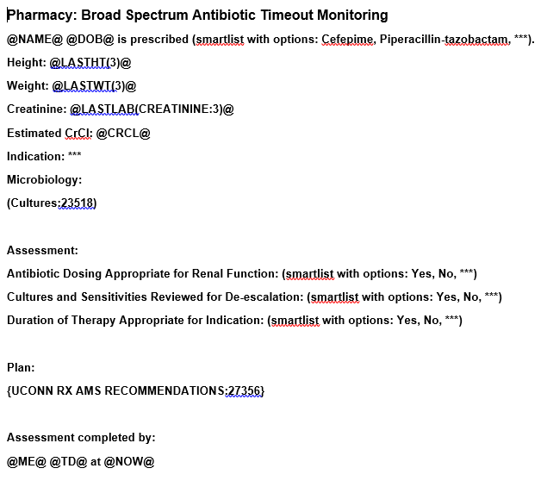
Daily I-Vent for Cefepime and Piperacillin-Tazobactam
Type:
Therapeutic Monitoring
Subtype:
Antibiotic Timeout
NOTE: to be used INSTEAD of the
previous daily renal I-Vent

Slide 45
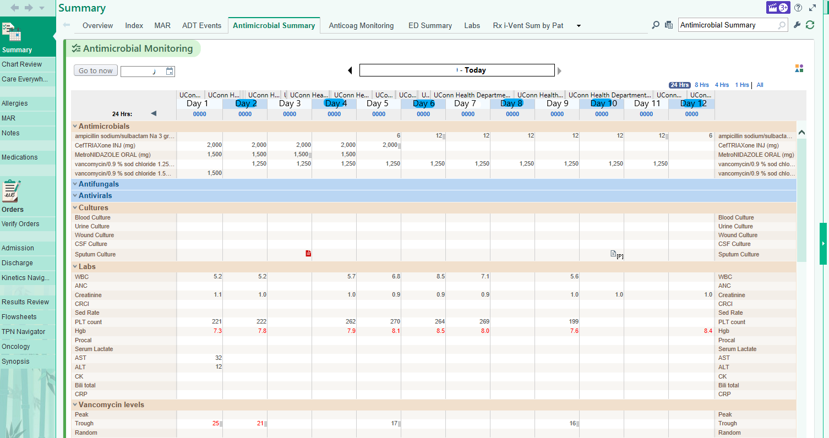
If this tab does not appear, use the wrench tool to add it
Useful tool for trending values (WBC, SCr, Temp, Urine Output), as well as
determining days of therapy and evaluating drug levels, dose timing, and cultures.

Slide 47
General Guidance for Treatment Durations
Pneumonia
5-7 days
Skin and Soft Tissue
5-14 days
UTI (Pyelonephritis)
FQs (5-7 days), TMP-SMX (7-10 days), β-Lactams (10-14 days)
Bacteremia
Gram Negative: 7-14 days
Gram Positive (Staph. aureus): 14 days from 1st negative blood culture
Intra-Abdominal
5 days after source control (longer courses if source control suboptimal or uncertain)
COPD exacerbation
5-7 days
Meningitis
10-21+ days depending on specific pathogen

