Slide 1
Aminoglycoside Collaborative Practice Dosing Protocol
Created by: Andrew Fratoni, PharmD
Gillian Kuszewski, PharmD

Slide 2
IV Aminoglycosides
Gentamicin
Tobramycin*
Amikacin*
*Restricted Antibiotics at UConn Health

Slide 3
Aminoglycoside Drug Class Principles
Good bactericidal activity against gram negative organisms
Typically used in combination with other antibiotics, both empirically and definitively, for treating severe infections caused by Pseudomonas aeruginosa and other multidrug-resistance gram negative organisms
Synergistic effect against gram positive pathogens such as Enterococcus spp., which cause infective endocarditis
Used in combination with a beta-lactam or vancomycin

Slide 4
AG Dosing Strategies in Protocol
High-Dose Extended Interval
Default strategy for all documented/suspected gram-negative infections unless contraindications apply
Optimizes PK and PD parameters and C_{MAX}:MIC for concentration dependent bactericidal activity against gram-negative pathogens
Reduces trough concentration and duration of renal and otic tissue exposure to potentially minimize risk of toxicity without compromising efficacy by taking advantage of the post antibiotic effect
Traditional Dosing
Special-Indication Dosing
Ex – synergistic agent for gram positive infection

Slide 5
High-Dose Extended Interval - Defaults
Determine if patient meets any contraindications for this dosing strategy:
Dialysis
Estimated CrCl < 20 mL/min
Unstable renal function with worsening renal function prior to or during therapy (50% increase in SCr from baseline)
Ascites, severe liver disease, or excessive third spacing of fluids
Pregnancy
Burns (>20% BSA)
Cystic Fibrosis
Use of AG as a synergistic agent for a gram positive infection
For contraindications 1-7, traditional dosing will be used, and for 8, special-indication dosing will be used

Slide 6
Ordering in EPIC

Slide 7
Order Set Screenshots – Provider to Dose
High-Dose Extended Interval
Traditional Dosing Load
Traditional Dosing Maintenance
Based on Renal Function

Slide 8
Order Set Screenshots – Pharmacy to Dose
Provider Selects:
Dosing Strategy
Indication
Aminoglycoside
NOTE: Provider does NOT order the initial dose like VCP, Pharmacy does.

Slide 9
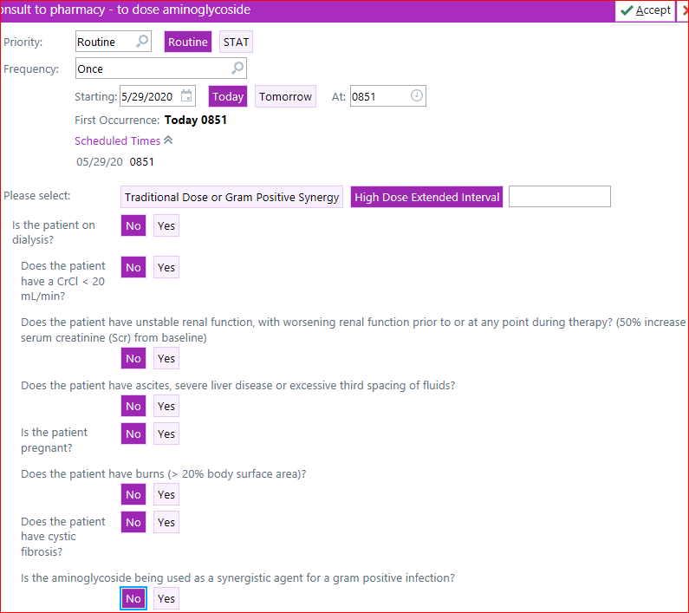
Pharmacy to Dose will Trigger Consult to Guide Dosing Strategy
Reviews High-Dose Strategy contraindications to ensure appropriate strategy is ordered

Slide 10
Placeholder Order for Awareness

Slide 11
Pharmacist Responsibilities
While consult is active pharmacy will place all dosing orders and related lab monitoring
Pharmacy will document notes for dosing plans and continued monitoring in response to lab values or dosing changes
Pharmacy will notify the provider of:
Decline in renal function (> 0.5 mg/dL and/or >2 fold increase in SCr)
Supratherapeutic serum concentrations following scheduled trough or random serum measures

Slide 12
Provider Responsibilities
Complete consult order to guide dosing strategy when initiating
Review pharmacists notes for plan awareness
Communicate important related clinical changes to pharmacist as needed
Discontinue medication orders and related consult when therapy is no longer needed

Slide 13
Questions?
Contact your floor pharmacist via Voalte
Additional Contacts:
Gillian Kuszewski, PharmD
kuszewski@uchc.edu
Jeff Aeschlimann, PharmD
aeschlimann@uchc.edu
Sean Johnston, RPh
johnston@uchc.edu

