Slide 1
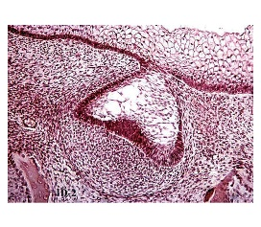
Academic Information Technology Services
Technology Training Workshops
WebEx Video Conferencing
Video Recording
Digital Microscopy
Instructional Design

Slide 2
HuskyCT Basics

Slide 3
Getting Started/HuskyCT Basics

Slide 4
Logging In
Navigate to one of the addresses below and log on to HuskyCT the universities Learning Management System (LMS). HuskyCT is used to conduct online coursework and used for more than just document storage. You are able to conduct video sessions (Colloborate), create and post videos (voice overs etc using Kaltura), Assessments and Surveys and Assignments!
To log into HuskyCT you will need your NetID account information. If you don’t know it, please go to http:// netid.uconn.edu. If you have your NedID and have trouble logging please contact 860-486-HELP for resetting or account logon issues.
http://huskyct.uconn.edu
http://lms.uconn.edu
http://learn.uconn.edu

Slide 5
My Courses Page
Course List
Instructor Page
Student Help
http://huskyct.uconn.edu
http://lms.uconn.edu
http://learn.uconn.edu

Slide 6
Basic Course Building in HuskyCT
Availability only Refers to visibility to Students
Menu items, Content Area, Tool link, web link
(Create) Item, file, web link
Content Management
Direct Link from Content Site

Slide 7
Announcements
Announcements Date restriction
Email goes out either way. Automatically or queue

Slide 8
Users (Enrollment)
Enroll users
Find users to enroll
Search bar is for students/staff already enrolled
Find users to enroll grey button

Slide 9
Multimedia & Web Conferencing
Kaltura
Collaborate
YouTube

Slide 10
Student Preview
Trial & Error
Preview Student Access
Take Tests & Quizzes

Slide 11
Where to find help?
health.uconn.edu/aits
abouthuskyct.uconn.edu
irc.uconn.edu

Slide 12
Questions

