Slide 1
Updated Vancomycin Collaborative Practice

Slide 2
Background
Vancomycin consensus guidelines updated in 2020
Biggest change – from trough based to AUC based monitoring
Serum trough concentrations of 10-20 mg/L are not as accurate a predictor of achieving an AUC/MIC of 400-600 as originally thought
The achievement of an AUC/MIC of > 400 within the first 48 hours of therapy is associated with improved outcomes in patients with documented serious MRSA infections
AUC/MIC values of >600 appear to be associated with higher risks of vancomycin-associated nephrotoxicity
Additional data on PK for special populations (extreme obesity, renal replacement, critical illness, etc.)

Slide 3
Major Updates to VCP
Loading dose
Therapeutic monitoring
Targeting AUC/MIC instead of troughs
Identification of patients who require additional monitoring
MRSA nasal swab
Pharmacist now have ability to order MRSA nasal swabs and discontinue vancomycin if negative

Slide 4
New Vancomycin Loading Dose
Loading dose of 25 mg/kg (based on total body weight)
Dose will be rounded to the nearest 250 mg increment for doses below 2000mg and to the nearest 500mg for doses above 2000mg
Pharmacy will not have 2750 mg or 2250mg dose
Dose will be rounded to either 2000mg, 2500 mg, or 3000 mg
Max loading dose: 3000 mg

Slide 5
Initial Vancomycin Regimen
Maximum: 2000 mg per dose, 4000 mg per day
No option to pick a therapeutic trough range anymore
AUC/MIC target of 400-600 mg-h/L will be used by the pharmacist to develop the initial vancomycin dosing regimen for ALL patients
It is important to note that there may be patients whose regimens result in a “therapeutic” AUC but whose troughs may be below 10 mg/L
Notes:
Verbalize that some regimens may have trough between 7-9 and that is okay

Slide 6
Therapeutic Monitoring
Serum peak and trough blood draws for determination of vancomycin concentrations should ONLY be ordered/assessed if the therapy continues for at least 3 days (72 hours) EXCEPT in certain patients (listed on next slide)
Day-shift pharmacist performing the patient chart reviews will be responsible for scheduling peak/troughs ONLY AFTER 72 hours have past.
If the patient will hit the 72 hour mark later that day, it is OK to wait until the next day to schedule the levels (responsibility will then fall on the pharmacist completing chart reviews the next day).
Delayed frequency in monitoring for most patients
% of patients that have stopped therapy before 72 hours
Nearly all vancomycin associated nephrotoxicity occurs after 3 days of therapy
Notes:
If 72 hours have not passed during the time of the review but the patient will reach the 72 hour mark later that day, then the responsibility to schedule the levels will fall on the pharmacist doing the review the NEXT day. For example if the pharmacist doing the review notices that the vanco therapy will reach 72 hours at 6 pm that night, the pharmacist on day shift that day does not need to schedule the peak/random. It will be the responsibility of the pharmacist the next day to then schedule the trough/peak because then 72 hours would have past. The levels do not need to be drawn at exactly 72 hours, only after 72 hours have past. Even if the 72 hour mark will occur later on the same pharmacist shift, it is okay to wait until the next day during the reviews to schedule the trough/peak.

Slide 7
Patients who may require early monitoring
Serum vancomycin peak, trough, and/or random serum concentrations can be ordered and assessed PRIOR TO 72 hours of therapy ONLY in the following clinical situations:
Critically-Ill patients (ICU patients) with or without hemodynamic instability
Patients with a BMI > 40
Patients with documented positive blood cultures for gram-positive cocci and/or patients with suspected pneumonia and a positive MRSA PCR nasal swab
Any patients with substantial acute alterations in renal function
Patients on HD or other continuous renal replacement
Patients with anticipated hospital discharge prior to 72 hours of therapy who need outpatient vancomycin therapy

Slide 8
Therapeutic Monitoring
Same general approach as peaks and troughs for aminoglycosides
The trough blood draw will be scheduled to occur within one hour prior to the start of an infusion of a dose
The peak blood draw will be scheduled to occur 1-2 hours after the end of that same dose infusion
Ideally should occur within 1-2 hours but up to 3 hours is acceptable

Slide 9
Interpreting Peaks and Troughs
It is important to note that there may be patients whose regimens result in a “therapeutic” AUC but whose troughs may be below 10 mg/L
ALL regimens resulting in a trough concentration > 20 mg/L will be considered supratherapeutic

Slide 10
MRSA PCR Nasal Swab
Pharmacists can enter an order in Epic for a MRSA PCR nasal swab in a patient who has a probable or definitive diagnosis of pneumonia
If a patient with documented/suspected pneumonia has a documented negative MRSA PCR nasal swab test, the pharmacist can discontinue the order for IV vancomycin
Prior to discontinuing the order, the pharmacist should contact the primary care team to alert them of the order discontinuation
Notes:
Discontinuation of vanco should be documented in a note posted to the chart

Slide 11
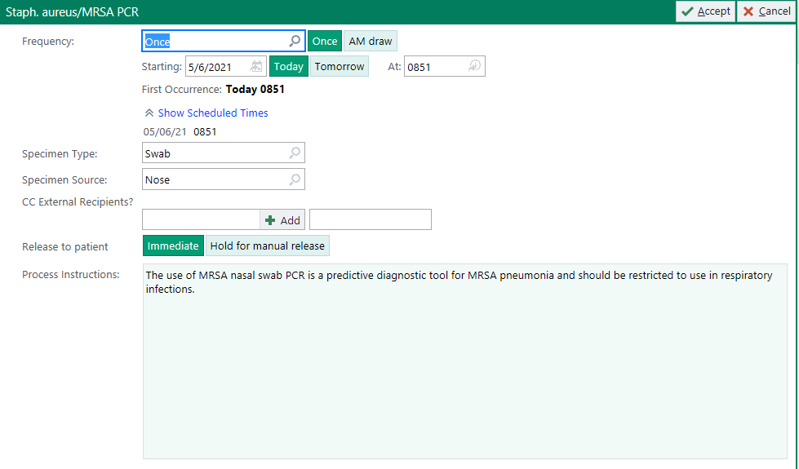
To order a MRSA nasal swab, go to Orders and type in “MRSA.” The following order will come up:

Slide 12
Patient Case #1
Age: | 49
Sex: | Female
Weight: | 136 kg
Height: | 172.2 cm
SCr: | 0.6 mg/dL
BMI: | 46
ICU Stay?: | N
Indication: | Prosthetic Joint Infection
AUC/MIC target | 400-600
Loading dose?
Notes:
Important to note that this patient’s BMI because this will impact vanco monitoring
Example of a patients loading that would need to be rounded to either 2500mg or 3000mg
Double check if epic will be auto-rounding based on doses available

Slide 13
Patient Case #1
Age: | 49
Sex: | Female
Weight: | 136 kg
Height: | 172.2 cm
SCr: | 0.6 mg/dL
BMI: | 46
ICU Stay?: | N
Indication: | Prosthetic Joint Infection
AUC/MIC target | 400-600
Loading dose?
136 kg x 25 mg/kg = 3400 mg
Rounded to 3000 mg
Notes:
Important to note that this patient’s BMI because this will impact vanco monitoring
Example of a patients loading that would need to be rounded to either 2500mg or 3000mg
Double check if epic will be auto-rounding based on doses available

Slide 14
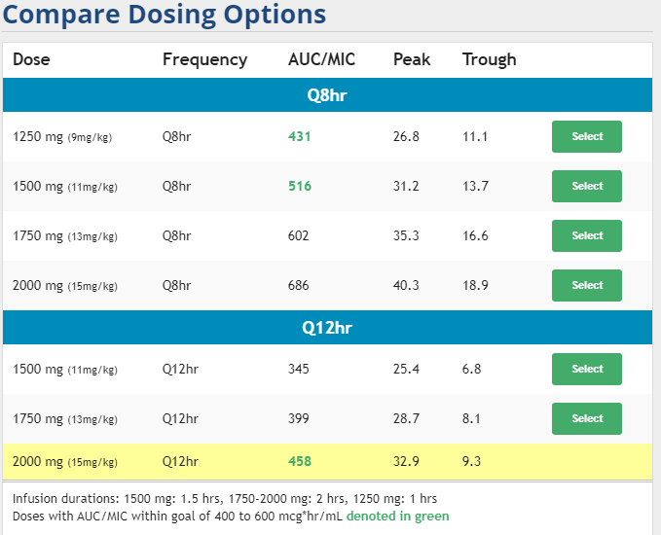
Patient Case #1
Notes:
Important to note that even though the trough is 9.3 the predicted AUC/MIC is still within the therapeutic range
Mention compare dosing options table to look that a quick look at what the other dosing strategies predicted AUC/MIC
Will probably need outpatient vanco – stay away from 8 hours

Slide 15
Patient Case #1
When should peaks and troughs be drawn?
Dosing Regimen
Loading dose: 3000 mg
given at 17:49
Maintenance dose:
2000 mg every 12 hours
(timed for 0600 and 1800)
Notes:
The trough blood draw will be scheduled to occur within one hour prior to the start of an infusion of a dose
The peak blood draw will be scheduled to occur 1-2 hours after the end of that same dose infusion

Slide 16
Patient Case #1
When should peaks and troughs be drawn?
Dosing Regimen
Loading dose: 3000 mg
given at 17:49
Maintenance dose:
2000 mg every 12 hours
(timed for 0600 and 1800)
Patient’s BMI is >40
Patient can receive vancomycin monitoring before 72 hours of therapy
Trough and peak will be timed around 3rd or 4th dose
Trough scheduled for 0530
Troughs should be taken within one hour prior to start of infusion
Peak scheduled for 0930
If dose is hung at 0600, the infusion will end at 0830
Peak is properly timed if within 1-2 hour after end of infusion (up to 3 hours after is acceptable)
Notes:
The trough blood draw will be scheduled to occur within one hour prior to the start of an infusion of a dose
The peak blood draw will be scheduled to occur 1-2 hours after the end of that same dose infusion

Slide 17
Pharmacy: Initial IV Vancomycin Dosing
@NAME@ is a 49 year old female who has been initiated on Vancomycin for Empiric therapy for Prosthetic Joint Infection.
Height: 172.2 cm
Actual Body Weight: 136 kg
Temperature: 38 C
BUN: @LASTLAB(BUN)@
SCr: 0.6 mg/dL
Estimated CrCl: >120 mL/min
WBC: 18
Albumin: @LASTLAB(ALBUMIN)@
Microbiology
Cultures Drawn? {YES/NA/NO/***:28797}
@MICRO30@
@LASTLABRX(MRSA)@
MRSA Nasal Swab ordered (confirmed or suspected pneumonia): {Yes, pending/Yes, resulted –Negative –Positive/No, not appropriate for indicted infection or history of confirmed MRSA infection:32610}
Special Dosing Considerations:
Patient admitted to the ICU with critical illness? {(Yes or No):32615}
Renal Considerations:{Renal Considerations:32608} No
BMI >40), and/or Actual Body Weight > 40% of Ideal Body Weight? {(Obesity-Yes or No):32614}
Documented positive blood cultures with gram positive cocci?:{(Yes or No):32616}
Patient close to hospital discharge with need for continuation of vancomycin as an outpatient (with need for either the start of vancomycin therapy prior to discharge or a change in the current vancomycin regimen based on a serum trough concentration)? {(Yes or No):32617}
Additional considerations for serum creatinine monitoring every 48 hours:{Additional considerations:32612} No

Slide 18
Plan:
Monitoring will be: {Early or Standard:32613}
@VANCODOSES@
Loading Dose: Vancomycin 3000 mg IV once
Maintenance Regimen: Pharmacy will start Vancomycin at a dose 2000 mg IV every 12 hours
Pharmacy scheduled {UCONN RX VANCOMYCIN TROUGH RANDOM:30219} on {TIME; MONTH, DAY, YEAR, TIME:30231}SCr on {TIME; MONTH, DAY, YEAR, TIME:30231}
Predicted AUC: 458
Additional Comments: Pharmacy will continue to monitor daily and if indicated, adjust dose and/or frequency, order lab work as appropriate per the Pharmacy and Therapeutics Committee approved collaborative practice until discontinuation of the medication.
Assessment completed by:
@ME@ @TD@ at @NOW@
Collaborative Practice Agreement found here:
https://health.uconn.edu/pharmacy/staff-references/vanco-collaborative-practice/

Slide 19
Patient Case #1 continued
Day | Dose | Time | Dose
1 | 1 | 17:49 | 3000 mg
2 | 2 | 06:10 | 2000 mg
2 | 3 | 17:55 | 2000 mg
 |  | 05:35 Trough = | 11
3 | 4 | 05:40 | 2000 mg
 |  | 10: 20 Peak = | 34
Notes:
Infusion ended at 8:10 (2 ½ hours)
Peak was drawn 2 hours 10 mins after infusion
Trough was drawn 5 mins before infusion
Put in the peak = actual time it was drawn
Trough – add the dosing interval to the time it was taken

Slide 20
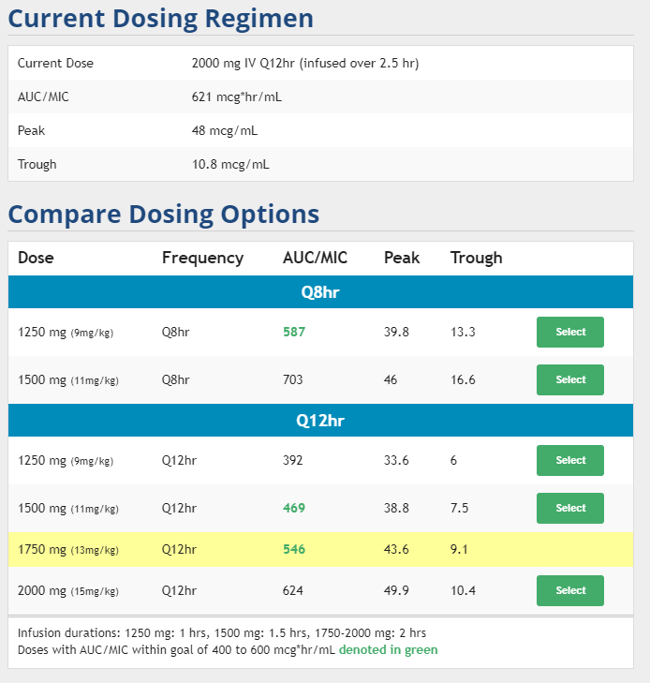
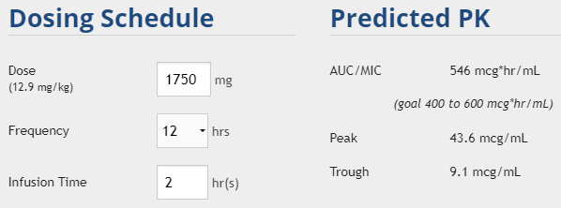
Patient Case #1 continued
**Patient as a prosthetic joint** infection and may need outpatient IV therapy – avoid q8h dosing
Notes:
Current regimen – even though the trough is 10.8 the AUC/MIC is above 600
Modify since same frequency

Slide 21
Pharmacy: Follow-up IV Vancomycin Dosing
@NAME@ is a 49 year old female who has been initiated on Vancomycin for Empiric therapy for Prosthetic Joint Infection.
Temperature: 37 C
BUN: @LASTLAB(BUN:3)@
SCr: 0.6 mg/dL
Estimated CrCl: >120 mL/min
WBC: 15
Culture Results:
Body Fluid Culture: @LASTLAB(LAB269)@ Tissue Culture lab results: @LASTLAB(LAB2980)@ Gram Stains Lab results: @LASTLAB(LAB250)@ Wound Culture-Superficial: @LASTLAB(LAB503)@ Wound Culture-Deep: @LASTLAB(LAB897)@
@LASTLABRX(MRSA)@
Current Vancomycin Dosing: 2000 mg IV every 12 hours
Most Recent Vancomycin Level(s):
@RESULAST(VANCOPEAK:1)@ 34
@RESULAST(VANCOTROUGH:1)@ 11
@RESULAST(VANCORANDOM:1)@
Calculated AUC: 621

Slide 22
Assessment:
Temperature is {IMPROVING/STABLE/WORSENING:21462}, WBC is {INCREASING/DECREASING/STABLE:15050}, Scr is {INCREASING/DECREASING/STABLE:15050}
Vancomycin level(s) is/are {UCONN RX VANCOMYCIN LEVEL CLASSIFICATION:25826}.
Special Dosing Considerations:
Patient admitted to the ICU with critical illness? {(Yes or No):32615}
Renal Considerations:{Renal Considerations:32608} None
BMI >40), and/or Actual Body Weight > 40% of Ideal Body Weight? {(Obesity-Yes or No):32614}
Documented positive blood cultures with gram positive cocci?:{(Yes or No):32616}
Patient close to hospital discharge with need for continuation of vancomycin as an outpatient (with need for either the start of vancomycin therapy prior to discharge or a change in the current vancomycin regimen based on a serum trough concentration)? {(Yes or No):32617}
Additional considerations for serum creatinine monitoring every 48 hours:{Additional considerations:32612} None
Plan:
Pharmacy verbally contacted covering provider *** on {TIME; MONTH, DAY, YEAR, TIME:30231} to notify of {UCONN RX VANCOMYCIN NOTIFY PROVIDER:31701}
{UCONN RX VANCOMYCIN CONTINUE/CHANGE:26796}
Vancomycin 1750 mg IV every 12 hours
Predicted level: 546 mcg/mL
Pharmacy scheduled {UCONN RX VANCOMYCIN TROUGH RANDOM:30219} on {UCONN RX TIME; MONTH, DAY, YEAR, TIME:30231} and SCr on {UCONN RX TIME; MONTH, DAY, YEAR, TIME:30231} due to {:31700}.
Additional Comments: Pharmacy will continue to monitor daily and if indicated, adjust dose and/or frequency, order lab work as appropriate per the Pharmacy and Therapeutics Committee approved collaborative practice until discontinuation of the medication.
Assessment completed by:
@ME@ @TD@ at @NOW@
Collaborative Practice Agreement found here:
https://health.uconn.edu/pharmacy/staff-references/vanco-collaborative-practice/

Slide 23
Patient Case #2
Age: | 86 yo
Sex: | Male
Weight: | 70 kg
Height: | 67.5"
SCr: | 1.3 mg/dL
BMI: | 25.2 kg/m2
ICU Stay?: | Yes
Indication: | Sepsis 2ndary to UTI
Loading dose?
Notes:
https://clincalc.com/Vancomycin/

Slide 24
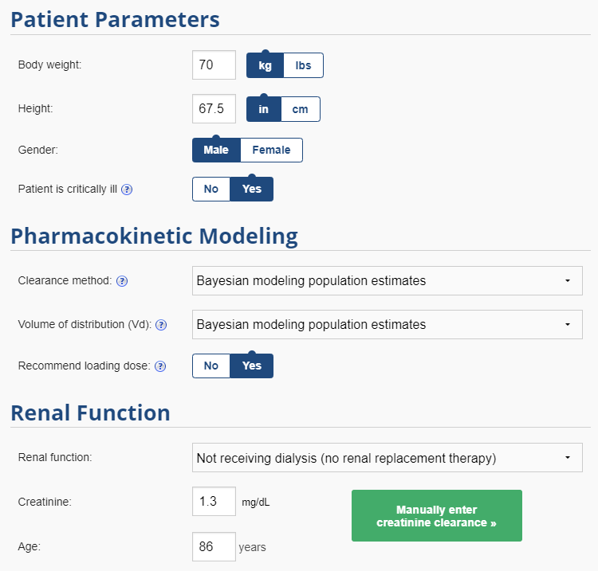
Patient Case #2
Age: | 86 yo
Sex: | Male
Weight: | 70 kg
Height: | 67.5"
SCr: | 1.3 mg/dL
BMI: | 25.2 kg/m2
ICU Stay?: | Yes
Indication: | Sepsis 2ndary to UTI
Loading dose?
70 kg x 25 mg/kg = 1750mg

Slide 25
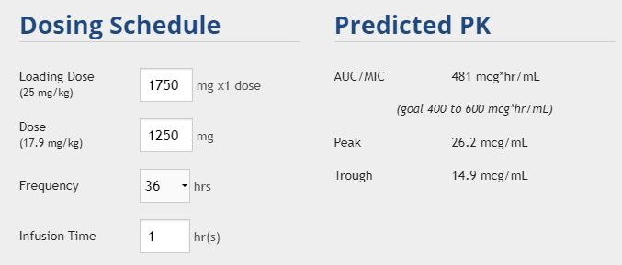
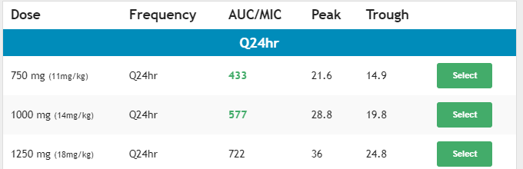
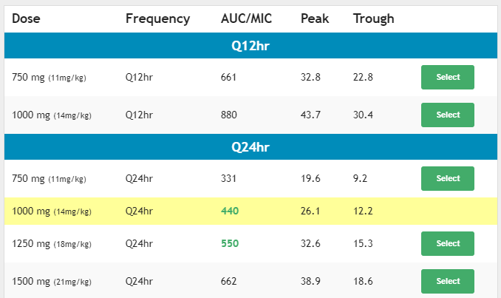
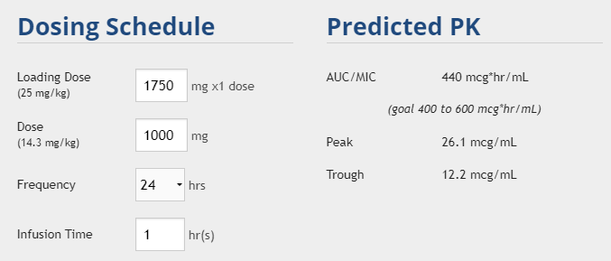
Patient Case #2 continued
**Avoid every 36 hour dosing**
Results if critically ill was not selected
Notes:
1000 mg q24h
Avoid the q36hr

Slide 26
Patient Case #2 continued
When should peaks and troughs be drawn?
Dosing Regimen
Loading dose: 1750 mg
given at 10:18
Maintenance dose:
1000 mg every 24 hours
(timed for 10:00)
Notes:
The trough blood draw will be scheduled to occur within one hour prior to the start of an infusion of a dose
The peak blood draw will be scheduled to occur 1-2 hours after the end of that same dose infusion

Slide 27
Patient Case #2 continued
When should peaks and troughs be drawn?
Dosing Regimen
Loading dose: 1750 mg
given at 10:18
Maintenance dose:
1000 mg every 24 hours
(timed for 10:00)
Patient is critically ill
Should receive vancomycin monitoring before 72 hours of therapy
Trough and peak will be timed around 3rd dose (2nd maintenance dose)
Trough scheduled for 0930
Troughs should be taken within one hour prior to start of infusion
Peak scheduled for 1200
If dose is hung at 1000, the infusion will end at 1100
Peak is properly timed if within 1-2 hour after end of infusion (up to 3 hours after is acceptable)
Notes:
The trough blood draw will be scheduled to occur within one hour prior to the start of an infusion of a dose
The peak blood draw will be scheduled to occur 1-2 hours after the end of that same dose infusion

Slide 28
Pharmacy: Initial IV Vancomycin Dosing
@NAME@ is a 86 year old male who has been initiated on Vancomycin for Empiric therapy for UTI, sepsis.
Height: 67.5”
Actual Body Weight: 74.1 kg
Temperature: 38.5 C
BUN: @LASTLAB(BUN)@
SCr: 1.3 mg/dL
Estimated CrCl: 43 mL/min
WBC: 21
Albumin: @LASTLAB(ALBUMIN)@
Microbiology
Cultures Drawn? {YES/NA/NO/***:28797}
@MICRO30@
@LASTLABRX(MRSA)@
MRSA Nasal Swab ordered (confirmed or suspected pneumonia): {Yes, pending/Yes, resulted –Negative –Positive/No, not appropriate for indicted infection or history of confirmed MRSA infection:32610}
Special Dosing Considerations:
Patient admitted to the ICU with critical illness? {(Yes or No):32615}
Renal Considerations:{Renal Considerations:32608} No
BMI >40), and/or Actual Body Weight > 40% of Ideal Body Weight? {(Obesity-Yes or No):32614}
Documented positive blood cultures with gram positive cocci?:{(Yes or No):32616}
Patient close to hospital discharge with need for continuation of vancomycin as an outpatient (with need for either the start of vancomycin therapy prior to discharge or a change in the current vancomycin regimen based on a serum trough concentration)? {(Yes or No):32617}
Additional considerations for serum creatinine monitoring every 48 hours:{Additional considerations:32612} No

Slide 29
Plan:
Monitoring will be: {Early or Standard:32613}
@VANCODOSES@
Loading Dose: Vancomycin 1750 mg IV once
Maintenance Regimen: Pharmacy will start Vancomycin at a dose 1000 mg IV every 24 hours
Pharmacy scheduled {UCONN RX VANCOMYCIN TROUGH RANDOM:30219} on {TIME; MONTH, DAY, YEAR, TIME:30231}SCr on {TIME; MONTH, DAY, YEAR, TIME:30231}
Predicted AUC: 577
Additional Comments: Pharmacy will continue to monitor daily and if indicated, adjust dose and/or frequency, order lab work as appropriate per the Pharmacy and Therapeutics Committee approved collaborative practice until discontinuation of the medication.
Assessment completed by:
@ME@ @TD@ at @NOW@
Collaborative Practice Agreement found here:
https://health.uconn.edu/pharmacy/staff-references/vanco-collaborative-practice/

Slide 30
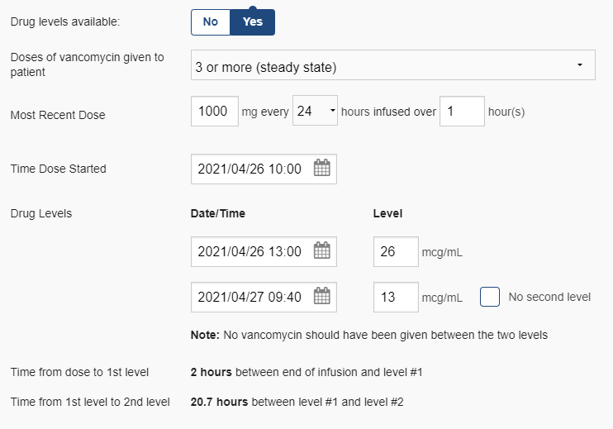
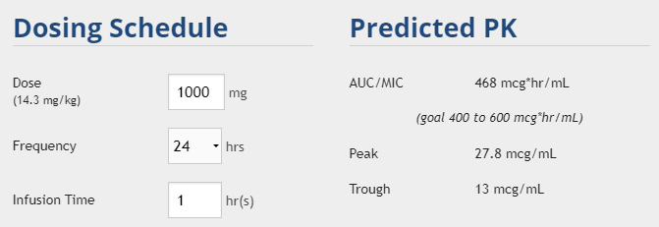
Patient Case #2 continued
Day | Dose | Time | Dose
1 | 1 | 10:18 | 1750 mg
2 | 2 | 09:30 | 1000 mg
 |  | 09:40 Trough = | 13
3 | 3 | 10:01 | 1000 mg
 |  | 13:05 Peak = | 26
Notes:
Put in the peak = actual time it was drawn
Trough – add the dosing interval to the time it was taken

Slide 31
Pharmacy: Follow-up IV Vancomycin Dosing
@NAME@ is a 86 year old male who has been initiated on Vancomycin for Empiric therapy for UTI, sepsis.
Temperature: 38 C
BUN: @LASTLAB(BUN:3)@
SCr: 1.3 mg/dL
Estimated CrCl: 43 mL/min
WBC: 18
Culture Results:
Body Fluid Culture: @LASTLAB(LAB269)@ Tissue Culture lab results: @LASTLAB(LAB2980)@ Gram Stains Lab results: @LASTLAB(LAB250)@ Wound Culture-Superficial: @LASTLAB(LAB503)@ Wound Culture-Deep: @LASTLAB(LAB897)@
@LASTLABRX(MRSA)@
Current Vancomycin Dosing: 1000 mg IV every 24 hours
Most Recent Vancomycin Level(s):
@RESULAST(VANCOPEAK:1)@ 26
@RESULAST(VANCOTROUGH:1)@ 13
@RESULAST(VANCORANDOM:1)@
Calculated AUC: 468

Slide 32
Assessment:
Temperature is {IMPROVING/STABLE/WORSENING:21462}, WBC is {INCREASING/DECREASING/STABLE:15050}, Scr is {INCREASING/DECREASING/STABLE:15050}
Vancomycin level(s) is/are {UCONN RX VANCOMYCIN LEVEL CLASSIFICATION:25826}.
Special Dosing Considerations:
Patient admitted to the ICU with critical illness? {(Yes or No):32615}
Renal Considerations:{Renal Considerations:32608} None
BMI >40), and/or Actual Body Weight > 40% of Ideal Body Weight? {(Obesity-Yes or No):32614}
Documented positive blood cultures with gram positive cocci?:{(Yes or No):32616}
Patient close to hospital discharge with need for continuation of vancomycin as an outpatient (with need for either the start of vancomycin therapy prior to discharge or a change in the current vancomycin regimen based on a serum trough concentration)? {(Yes or No):32617}
Additional considerations for serum creatinine monitoring every 48 hours:{Additional considerations:32612} None
Plan:
Pharmacy verbally contacted covering provider *** on {TIME; MONTH, DAY, YEAR, TIME:30231} to notify of {UCONN RX VANCOMYCIN NOTIFY PROVIDER:31701}
{UCONN RX VANCOMYCIN CONTINUE/CHANGE:26796}
Vancomycin 1000 mg IV every 24 hours
Predicted level: 468 mcg/mL
Pharmacy scheduled {UCONN RX VANCOMYCIN TROUGH RANDOM:30219} on {UCONN RX TIME; MONTH, DAY, YEAR, TIME:30231} and SCr on {UCONN RX TIME; MONTH, DAY, YEAR, TIME:30231} due to {:31700}.
Additional Comments: Pharmacy will continue to monitor daily and if indicated, adjust dose and/or frequency, order lab work as appropriate per the Pharmacy and Therapeutics Committee approved collaborative practice until discontinuation of the medication.
Assessment completed by:
@ME@ @TD@ at @NOW@
Collaborative Practice Agreement found here:
https://health.uconn.edu/pharmacy/staff-references/vanco-collaborative-practice/
Notes:
AUC/MIC- insteat of leve

Slide 33
Patient Case #3
Age: | 57 years
Sex: | Male
Weight: | 74.5 kg
Height: | 69"
SCr: | 0.8 mg/dL
BMI: | 24 kg/m2
ICU Stay?: | No
Indication: | Pneumonia
Loading dose?

Slide 34
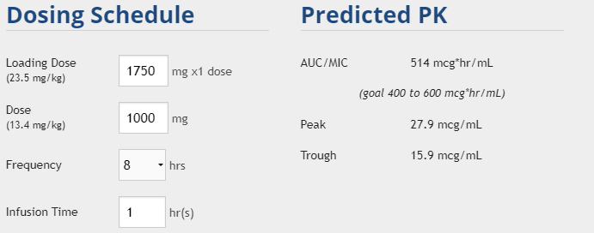
Patient Case #3
Age: | 57 years
Sex: | Male
Weight: | 74.5 kg
Height: | 69"
SCr: | 0.8 mg/dL
BMI: | 24 kg/m2
ICU Stay?: | No
Indication: | Pneumonia
Loading dose?
75 kg x 25 mg/kg = 1875mg
Rounded to 1750 mg
** Pharmacists can ** now order a MRSA swab if not already ordered

Slide 35
Patient Case #3
Dosing Regimen
Loading dose: 1750 mg
given at 13:04
Maintenance dose:
1000 mg every 8 hours
(timed for 21:00, 05:00, 13:00)
When should the peak and trough be drawn?

Slide 36
Patient Case #3
Dosing Regimen
Loading dose: 1750 mg
given at 13:04
Maintenance dose:
1000 mg every 8 hours
(timed for 21:00, 05:00, 13:00)
When should the peak and trough be drawn?
The patient has a BMI <40, no evidence of positive blood cultures for gram-positive cocci, is not admitted to the ICU, and has stable renal function.
Serum peak and trough blood draws for determination of vancomycin concentrations should ONLY be ordered/assessed if the therapy continues for at least 3 days (72 hours).

Slide 37
Patient Case #3 continued
MRSA swab is negative!
Pharmacist should contact team and alert them that the vancomycin will be discontinued

Slide 38
Traditional Hemodialysis
Keep it simple
Just about all patients will become therapeutic at loading dose of 25 mg/kg and 10 mg/kg maintenance dose
No need to check any more frequently than once weekly in someone on a stable HD schedule.
Notes:
Serum creatinine

