Slide 1


Academic Information Technology Services
Technology Training Workshops
WebEx Video Conferencing
Video Recording
Digital Microscopy
Instructional Design

Slide 2
Integrating video into Higher Education
Using Kaltura & Instructional Design methods to engage and increase learning and retention for students

Slide 3
Why Videos?

Slide 4
Reasons to incorporate video into courses
Demonstrate concepts – often more effective to show students how to complete a dissection than explain it with text
Multi-Sensory experience – videos help learners come away with a similar understanding
Dynamic experience – videos can incorporate different movement, animation, voice-over, images or sounds to keep learners engaged

Slide 5
Is a video suitable content for my course?
Determine if the concept or idea is engaging and pedagogically effective BEFORE jumping into video creation
Choose content that won't change significantly over time
Understand how the students will consume the content before creating it: on their own, in-class, as part of a group assignment, etc.
Median engagement time for students is 6 minutes, regardless of length of video (http://up.csail.mit.edu/other-pubs/las2014-pguo-engagement.pdf)

Slide 6
Engagement
Most learners refuse videos more than 15 minutes
Develop longer learning videos as multi content sessions
Microlearning
Ability for the learner to view multiple times

Slide 7
Kaltura: Video Management and Hosting System used by the Institution

Slide 8


Kaltura Video Management
Used to upload videos
Used to create videos
Share videos to all types of users
Restrict viewing to users
Integrated into HuskyCT (Blackboard)

Slide 9
http://kaltura.uconn.edu

Slide 10

Kaltura – Desktop Capture Application

Slide 11
Installation & Setup

Slide 12
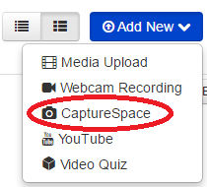
Installation & Setup
In order to install Kaltura CaptureSpace Desktop Recorder it involves a one time setup from HuskyCT
1. To begin, log into HuskyCT and select the ‘My Media’ link to get to your Kaltura media.
2. Click on the ‘Add New’ drop down and select CaptureSpace

Slide 13
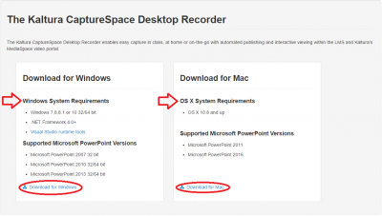
Installation & Setup
3. A download page will appear with links for both Mac and Windows. You will also notice software requirements here. Click on the link depending on your operating system to download the software. Once the download is finished, run the installer to begin installation.

Slide 14
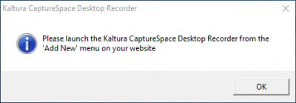
Installation & Setup
4. After the installation finishes, you are directed to “Please launch the Kaltura CaptureSpace Desktop Recorder from the ‘Add New’ menu on your website”. Click ok and repeat step 2 from this guide.

Slide 15
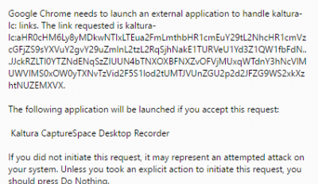
Installation & Setup
5. Your browser will then pop up and “External Protocol Request” window asking for you to launch the application. Click on the remember choice checkbox and click ‘Launch Application.’ Please note that every browser looks a little different but below is a picture of Chrome.
6. CaptureSpace is now configured with your user ID and you are ready to begin using the software.

Slide 16
Recording

Slide 17
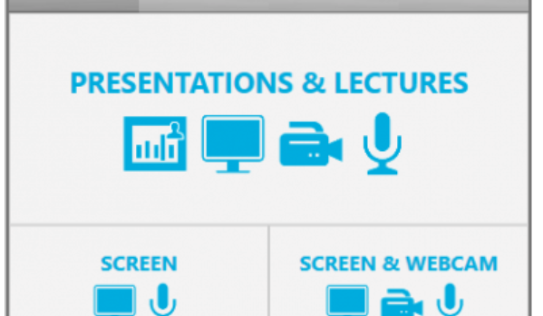
Recording
CaptureSpace Desktop Recorder
CaptureSpace has 5 different variations of recording.
Presentations & Lectures – This option allows for the recording of your webcam and screen as seperate sources. This is the best option to choose if recording your webcam and screen and allows for optimal viewing during playback.
Screen & Webcam – This option records your screen and webcam similar to before, however flattens the images down as a single video. This can cause issues if your webcam is hiding content from the screens. This method is not recommended.
Screen – This option is best when recording only your screen and audio but no webcam.
Webcam – This option is best when recording only your webcam.
Voice – This option is best for an only audio recording.

Slide 18
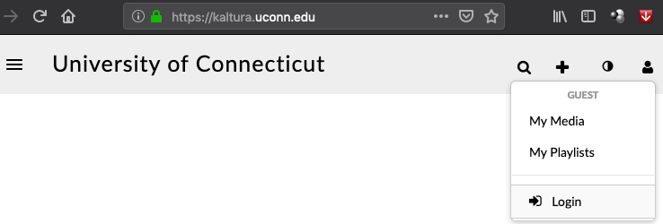
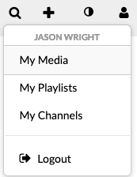
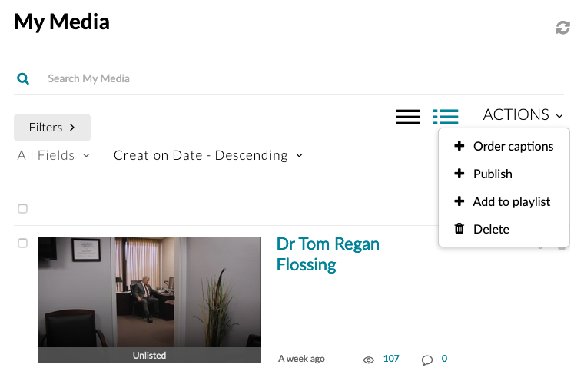
Publishing & Sharing
http://Kaltura.uconn.edu

Slide 19
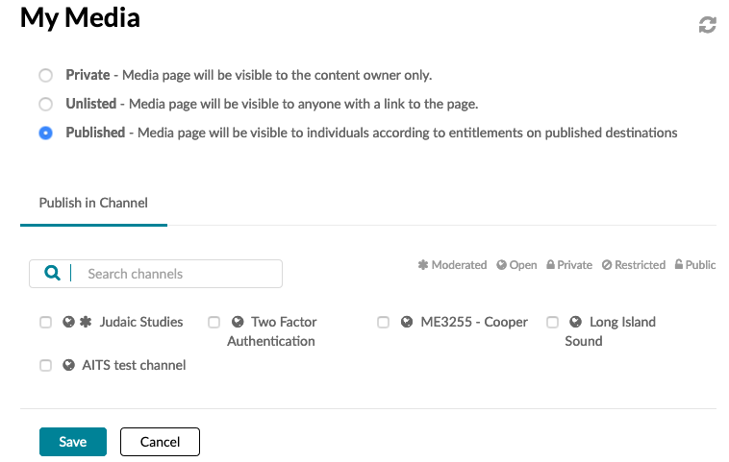
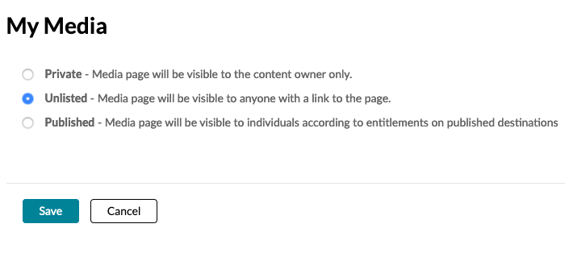
Publishing & Sharing
http://Kaltura.uconn.edu

