Slide 1
Warfarin Collaborative Practice at JDH-UCH
October 2015

Slide 2
Objectives
Summarize Warfarin Collaborative Practice P&T Approved Protocol
Discuss Warfarin Dosing Strategies and Resources
Outline Pharmacist Documentation of Warfarin Dosing and Education
Recall Vitamin K Use and Bridging Guidelines

Slide 3
Warfarin Collaborative Practice (WCP) at UCH/JDH
Anticoagulation National Patient Safety Goal and continues to be “featured” in FDA MedWatch
Anticoagulation medication variances
Protocol approved through P&T initially in January 2015
Documentation forms approved February 2015
Patient education documentation in LCR approved April 2015 and available in May 2015
APPE student participation in warfarin patient education June 2015 to present
Resident didactic continuing education on warfarin Summer 2015
Resident evaluation of WCP Fall 2015

Slide 4
WCP Protocol
Pharmacist must pass competency to participate
Adult inpatient with warfarin for specific indications included
Does not include patients status post orthopedic surgery
According to and in compliance with Section 91 of Public Act 10-7 and Connecticut General Statutes sec 20-631 “An Act Concerning Collaborative Practice Between Physicians and Pharmacists”
UCH/JDH pharmacists may design, implement, and monitor a therapeutic drug plan intended to manage oral warfarin therapy upon receipt of an order from the licensed provider

Slide 5
Purpose of WCP
Establish collaboration between providers and pharmacists with warfarin management
Standardized protocol based on current peer-reviewed literature
Maximize the therapeutic efficacy of oral warfarin therapy
Minimize the potential for adverse events

Slide 6
Procedure for WCP
Inpatients with warfarin order
MD dosed, RPh dosed
Pharmacists can order labs regardless of enrollment in WCP
Baseline PT/INR prior to initiation therapy
No lab value within 3 days prior
Practitioner will order WCP in CPOE
Initial dose
Indication
Target INR range

Slide 7
Responsibilities of the Provider
Will maintain ability to order warfarin if desired
Change to provider dosed order
Provider to discontinue therapy if treatment options and/or plan of care change
Overall anticoagulation needs (i.e. non-warfarin therapy)
Provider is responsible for ordering non-warfarin therapy, if required (e.g. unfractionated heparin, enoxaparin)
Discuss concerns with the pharmacist’s management of warfarin
Upon discharge, ordering outpatient INR and prescription for warfarin

Slide 8
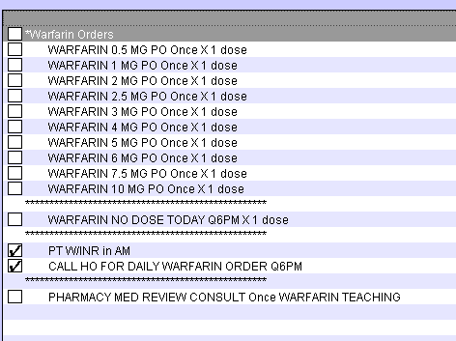
CPOE – Provider Dosed
□ Warfarin 0.5 mg PO Once x 1 dose
□ Warfarin 1 mg PO Once x 1 dose
□ Warfarin 2 mg PO Once x 1 dose
□ Warfarin 2.5 mg PO Once x 1 dose
□ Warfarin 3 mg PO Once x 1 dose
□ Warfarin 4 mg PO Once x 1 dose
□ Warfarin 5 mg PO Once x 1 dose
□ Warfarin 6 mg PO Once x 1 dose
□ Warfarin 7.5 mg PO Once x 1 dose
□ Warfarin 10 mg PO Once x 1 dose
************************************************************
□ Warfarin NO Dose Today q6pm x 1 dose
************************************************************
☑ PT w/INR in AM
Call HO for daily Warfarin orders
************************************************************
□ PHARMACY MED REVIEW CONSULT Once WARFARIN TEACHING

Slide 9
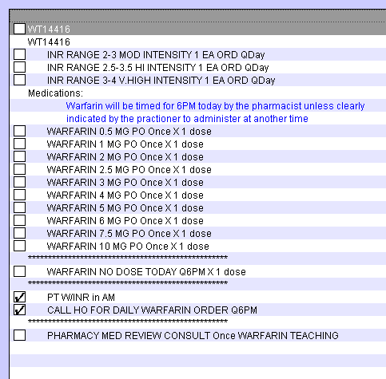
CPOE- RPh Dosed
Warfarin INR Range
□ INR Range 2-3 Mod Intensity
□ INR Range 2.5-3.5 High Intensity
Prescribers MUST select INITIAL Warfarin Dose
□ Warfarin 0.5 mg PO Once x 1 dose
□ Warfarin 1 mg PO Once x 1 dose
□ Warfarin 2 mg PO Once x 1 dose
□ Warfarin 2.5 mg PO Once x 1 dose
□ Warfarin 3 mg PO Once x 1 dose
□ Warfarin 4 mg PO Once x 1 dose
□ Warfarin 5 mg PO Once x 1 dose
□ Warfarin 6 mg PO Once x 1 dose
□ Warfarin 7.5 mg PO Once x 1 dose
□ Warfarin 10 mg PO Once x 1 dose
************************************************************
□ Warfarin NO Dose Today q6pm x 1 dose
************************************************************
☑ PT w/INR in AM
☑ Call HO for daily Warfarin orders ************************************************************
□ PHARMACY MED REVIEW CONSULT Once WARFARIN TEACHING

Slide 10
CPOE- RPh Dosed

Slide 11
CPOE- RPh Dosed

Slide 12
Responsibilities of the Pharmacist
Assuring warfarin is dosed on a daily basis appropriately
Consults will be performed daily 7:30am-5:30pm
New consults between 5:30pm-7:30am, evaluate the first dose and, if appropriate, verify the order
The following day, the day shift pharmacist will complete the consult
Order related lab work
PT/INR, CBC w/diff prior to initiation of warfarin therapy
Subsequent INRs ordered daily unless stable
CBC w/diff ordered every 3 days

Slide 13
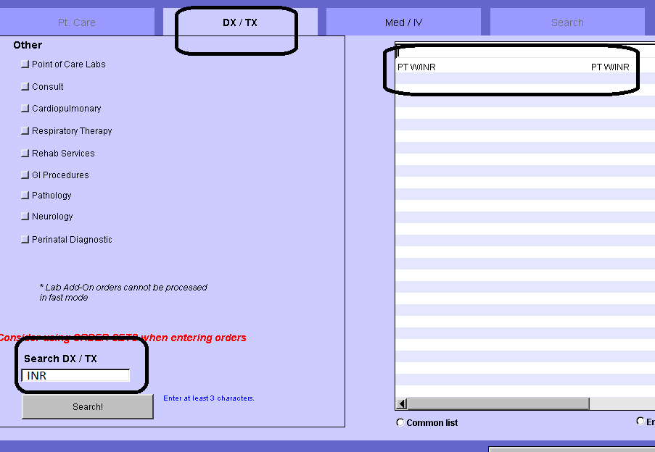
Ordering Labs
PT/INR

Slide 14
Ordering Labs

Slide 15
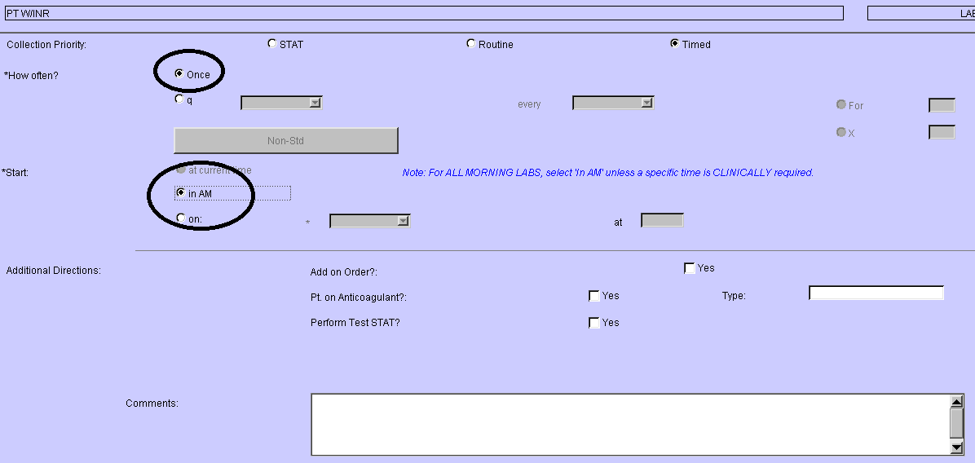
Ordering Labs
Can draw with AM labs

Slide 16
Determination of Dose
Review and collect patient data necessary to develop an optimized warfarin dose
Baseline, daily INR
CBC w/diff
Liver function tests
Albumin
Renal function
Previous warfarin history
INR goal and indication
Warfarin doses already received (or missed)
Drug interactions
S/S of bleeding such as heme positive stool and/or urine, low blood pressure

Slide 17
Indication | Target INR | Duration
Deep Vein Thrombosis (DVT)/Pulmonary Embolism (PE)
Provoked (Transient risk factors) | 2.5 (2-3) | 3 months and reassess
Unprovoked | 2.5 (2-3) | 3 months and reassess
Cancer | 2.5 (2-3) | indefinite
Upper Extremity DVT w/unremoved central venous catheter | 2.5 (2-3) | indefinite
APAS or 2 or more thrombophilic conditions | 2.5 (2-3) | indefinite
Recurrent DVT/PE | 2.5 (2-3) | indefinite
Orthopedic Thromboprophylaxis
Hip Fracture Surgery (HFS) or Total Hip Arthroplasty (THA) | 2.5 (2-3) | At least 10 days and up to 35 days post op
Total Knee Arthroplasty (TKA) | 2.5 (2-3) | At least 10 days and up to 35 days post op
Atrial Fibrillation (AF) or Atrial Flutter (AFL)
CHADS₂ Score = 0 (Low risk of stroke) | No therapy or Aspirin 75-325mg/day | indefinite
CHADS₂ Score = 1 (Intermediate risk of stroke) | 2.5 (2-3) | indefinite
CHADS₂ Score ≥ 2 (High risk of stroke) | 2.5 (2-3) | indefinite
Mitral Stenosis | 2.5 (2-3) | indefinite
Pre-Cardioversion (AF or AFL ≥ 48 hours or unknown duration) | 2.5 (2-3) | 3 weeks
Post-Cardioversion | 2.5 (2-3) | 4 weeks
Secondary Prevention of Cardioembolic Stroke
History of ischemic stroke or TIA and AF | 2.5 (2-3) | indefinite
Myocardial infarction (MI)
Anterior MI and LV thrombus or at high risk for LV thrombus (ejection fraction <40%, anteroapical wall motion abnormality) | 2.5 (2-3) | 3 months
Anterior MI and LV thrombus or at high risk for LV thrombus (ejection fraction <40%, anteroapical wall motion abnormality) undergo bare-metal stent | 2.5 (2-3) | 3 months
Anterior MI and LV thrombus or at high risk for LV thrombus (ejection fraction <40%, anteroapical wall motion abnormality) undergo drug-eluting stent | 2.5 (2-3) | 3-6 months
Systolic Left ventricular dysfunction with identified acute LV thrombus | 2.5 (2-3) | 3 months and reassess

Slide 18
Indication | Target INR | Duration
Rheumatic mitral valve disease (w/ left atrial diameter >55mm, left atrial thrombus, afib or previous systemic embolism) | 2.5 (2-3) | indefinite
Rheumatic mitral valve disease undergoing percutaneous mitral balloon valvotomy (PMBV) with preprocedural TEE showing left atrial thrombus | 3 (2.5-3.5) | Until thrombus resolution is documented by repeat TEE
Cryptogenic Stroke and Patent Foramen Ovale (PFO) or Atrial Septal Aneurysm
With recurrent event despite aspirin therapy | 2.5 (2-3) | indefinite
With evidence of DVT | 2.5 (2-3) | 3 months
Valve replacement – Bioprosthetic
Mitral | 2.5 (2-3) | 3 months
Valve replacement – Mechanical
Aortic | 2.5 (2-3) | indefinite
Bileaflet or Medtronic Hall tilting disk | 2.5 (2-3) | indefinite
Ball and cage | 2.5 (2-3) | indefinite
Mitral | 3.0 (2.5-3.5) | indefinite
Bileaflet | 3.0 (2.5-3.5) | indefinite
Tilting disk | 3.0 (2.5-3.5) | indefinite
Ball and cage | 3.0 (2.5-3.5) | indefinite

Slide 19
Determination of Dose
Initial dosing considerations
Potential sensitivity to warfarin
Indication with goal INR ranges
Potential drug interactions

Slide 20
Warfarin Sensitivity
Patients with multiple high sensitivity risk factors may require a lower initiation dose and reduced maintenance doses.
Warfarin is a drug with high protein binding. Up to 99% of the drug is bound to plasma proteins. Patients who are malnourished with low albumins will have higher concentration of unbound drug.
Increased Warfarin Sensitivity
Increased INR Response | Increased Bleeding Risk
Baseline INR ≥ 1.5 Age > 65 Actual body weight < 45 kg or actual < ideal Malnourished/NPO > 3 days Hypoalbuminemia < 2 g/dL Chronic diarrhea Significant drug interactions Decompensated heart failure Asian race Malignancy | Current antiplatelet therapy Thrombocytopenia: platelet < 75 K/uL Significant hepatic disease: cirrhosis or total bilirubin > 2.4mg/dL Alcohol abuse history End stage renal disease GI bleed within past 30 days Surgery within past 2 weeks Intracranial bleed within past 30 days

Slide 21
Risk Assessment
CHADS2 score is a clinical prediction rule
Estimates risk of stroke in patients with non-rheumatic atrial fibrillation
Used to determine whether or not treatment is required with anticoagulation therapy
Condition |  | Points
C | Congestive Heart Failure | 1
H | Hypertension: BP consistently above 140/90 mmHg or treated w/ hypertensive medication | 1
A | Age ≥ 75 years | 1
D | Diabetes mellitus | 1
S₂ | Prior Stroke or TIA or Thromboembolism | 2
Annual Stroke Risk
CHADS₂ Score | Stroke Risk
0 | 1.9
1 | 2.8
2 | 4.0
3 | 5.9
4 | 8.5
5 | 12.5
6 | 18.2

Slide 22
Risk Assessment
CHA₂DS₂-VASc | Score | HAS-BLED | Score
Congestive heart failure | 1 | Hypertension (systolic blood pressure >160 mm Hg) | 1
Hypertension | 1 | Abnormal renal and liver function* (1 point each) | 1 or 2
Age ≥75 y | 2 | Stroke | 1
Diabetes mellitus | 1 | Bleeding tendency/predisposition* | 1
Stroke/TIA/TE | 2 | Labile INRs (if on warfarin)* | 1
Vascular disease (prior MI, PAD, or aortic plaque) | 1 | Elderly (eg, age >65 y) | 1
 |  | Drugs or alcohol (1 point each)* | 1 or 2
Aged 65 to 74 y | 1
Sex category (ie, female sex) | 1
Maximum score | 9 | Maximum score | 9
TIA indicates transient ischemic attack; TE, thromboembolic; INR, international normalized ratio; MI, myocardial infarction; and PAD, peripheral artery disease. CHA₂DS₂-VASc score of 0: recommend no antithrombotic therapy. CHA₂DS₂-VASc score of 1: recommend antithrombotic therapy with oral anticoagulation or antiplatelet therapy but preferably oral anticoagulation. CHA₂DS₂-VASc score ≥2: recommend oral anticoagulation.² A HAS-BLED score of ≥3 indicates that caution is warranted when prescribing oral anticoagulation and regular review is recommended.²
↵* Abnormal renal function is classified as the presence of chronic dialysis, renal transplantation, or serum creatinine ≥200 mmol/L. Abnormal liver function is defined as chronic hepatic disease (eg, cirrhosis) or biochemical evidence of significant hepatic derangement (bilirubin 2 to 3 times the upper limit of normal, in association with aspartate aminotransferase/alanine aminotransferase/alkaline phosphatase 3 times the upper limit normal, etc), history of bleeding or predisposition (anemia), labile INR (ie, time in therapeutic range <60%), concomitant antiplatelets or nonsteroidal anti-inflammatory drugs, or excess alcohol.
Use of the CHA₂DS₂-VASc and HAS-BLED Scores to Aid Decision Making for Thromboprophylaxis in Nonvalvular Atrial Fibrillation Deirdre A. Lane and
Gregory Y.H. Lip
Circulation. 2012;126:7 860-865

Slide 23
Drug and Food Interactions
Most interactions will start to have an effect within 3-5 days of concomitant therapy
Some exceptions have an effect within 7-14 days of dual therapy
Ex. amiodarone, carbamazepine and rifampin
Total weekly dose adjustment of either an increase or decrease
Usually by 30%
Some 50% (ex. amiodarone and rifampin)
Some experts advise holding nutrition formulas for 1–2 hours before and after warfarin to avoid interactions. In many cases adequate dilution and rinsing will avoid this interaction so do not hold nutrition formulas.
Patients receiving enteral nutrition will have more bound drug to plasma proteins due to high protein concentration in these products.

Slide 24
Determination of WCP Dose
Initiation Dosing vs. Maintenance Dosing
Baseline INR must be resulted prior to the verification of first dose
Current INR must be resulted prior to the verification of a dose adjustment
Baseline CBC with rechecking every 3 days
Adjustments based on current INR measurements and after assessment of:
-Missed doses
-Changes in medication orders drug interactions
-Diet
-Documentation of bleeding
-Other changes
Importance of clinical judgment to determine appropriate dose
Work with provider when necessary

Slide 25
Initial Dosing for Target INR Goal of 2 -3
Day | Warfarin Starting Dose | INR Value | Warfarin Increased Sensitivity Starting Dose
Day 1 | 5 mg | < 1.5 | 2.5 mg
Day 2 | 5 mg | < 1.5 | 2.5 mg
 | 2.5mg | 1.5 – 1.9 | 1 – 1.5 mg
 | 1 – 2.5 mg | 2 – 2.5 | 0.5 – 1 mg
 | 0 mg | > 2.5 | 0 mg
Day 3 | 5 – 10 mg | < 1.5 | 2.5 – 5 mg
 | 2.5 – 5 mg | 1.5 – 1.9 | 1 – 2.5 mg
 | 0 – 2.5 mg | 2 – 3 | 0 – 1 mg
 | 0 mg | > 3 | 0 mg
Day 4 | 10 mg | < 1.5 | 5 mg
 | 5 – 7.5 mg | 1.5 – 1.9 | 3 – 5 mg
 | 0 – 5 mg | 2 - 3 | 0 – 2.5 mg
 | 0 mg | > 3 | 0 mg
Day 5 | 10 mg | < 1.5 | 5 mg
 | 7.5 – 10 mg | 1.5 – 1.9 | 3 – 5 mg
 | 0 – 5 mg | 2 - 3 | 0 – 2.5 mg
 | 0 mg | > 3 | 0 mg
Day 6 | 7.5 – 12.5 mg | < 1.5 | 3 – 7.5 mg
 | 5 – 10 mg | 1.5 – 1.9 | 2.5 – 5 mg
 | 0 – 7.5 mg | 2 – 3 | 0 – 4 mg
 | 0 mg | > 3 | 0 mg

Slide 26
Initial Dosing for Target INR Goal of 2.5 -3.5
Day | Warfarin Starting Dose | INR Value | Warfarin Increased Sensitivity Starting Dose
Day 1 | 5 mg | - | 2.5 mg
Day 2 | 5 mg | < 1.5 | 2.5 mg
 | 2.5 mg | 1.5 – 1.9 | 1 – 1.5 mg
 | 2.5 mg | 2 – 2.5 | 1 – 1.5 mg
 | 1 – 2.5 mg | 2.5 – 3 | 0.5 – 1 mg
 | 0.5 – 1 mg | 3 – 3.5 | 0.5 mg
 | 0 mg | > 3.5 | 0 mg
Day 3 | 5 – 10 mg | < 1.5 | 2.5 – 5 mg
 | 2.5 – 5 mg | 1.5 – 1.9 | 1 – 2.5 mg
 | 2.5 mg | 2 – 2.5 | 1.25 mg
 | 2.5 mg | 2.5 – 3 | 1.25 mg
 | 1 mg | 3 – 3.5 | 0.5 mg
 | 0 mg | > 3.5 | 0 mg
Day 4 | 10 mg | < 1.5 | 5 mg
 | 5 – 7.5 mg | 1.5 – 1.9 | 2.5 – 4 mg
 | 2.5 – 5 mg | 2 – 2.5 | 1.25 – 2.5 mg
 | 2.5 – 5 mg | 2.5 – 3.5 | 1 – 2.5 mg
 | 0 mg | > 3.5 | 0 mg
Day 5 | 10 mg | < 1.5 | 5 mg
 | 7.5 – 10 mg | 1.5 – 1.9 | 3 – 5 mg
 | 0 – 5 mg | 2 – 2.5 | 2.5 mg
 | 2.5 – 5 mg | 2.5 – 3.5 | 1.25 – 2.5 mg
 | 0 mg | > 3.5 | 0 mg
Day 6 | 7.5 – 12.5 mg | < 1.5 | 4 - 6 mg
 | 5 – 10 mg | 1.5 – 1.9 | 2.5 - 5 mg
 | 5 – 7.5 mg | 2 – 2.5 | 2.5 - 4 mg
 | 2.5 – 7.5 mg | 2.5 – 3.5 | 1.25 - 4 mg
 | 0 mg | > 3.5 | 0 mg

Slide 27
Maintenance Dosing
If on warfarin prior to admission, their home dose may be used if appropriate
Evaluate the patient for any changes in co-morbidity, warfarin sensitivity, warfarin clearance or potential drug interactions
No changes, continue the dose as prescribed by the clinic and monitor the patient daily
If there are changes, evaluate the patient for a dosage change and try to identify the reason for current INR value
UCH Anticoagulation Clinic and the INR target range
Warfarin should be adjusted based on current INR measurements
Review factors daily for changes
Obtain baseline INR and CBC
Obtain daily INR values unless the patient has been maintained on the same warfarin dose during inpatient
Obtain CBC every 3 days

Slide 28
UCH Warfarin Clinic Note
Contact the clinic via email: anticoagda@uchc.edu

Slide 29
Continuation of Therapy: Warfarin Maintenance Dosing
Target INR 2 - 3 | Dosing Adjustment | Target INR 2.5-3.5
INR < 1.5 | consider booster dose of 1.5-2 times daily maintenance dose consider resumption of prior maintenance dose if factor causing decreased INR is transient, (i.e. missed warfarin doses) if dosage adjustment is needed increase maintenance dose by 10-20% | INR < 2
INR 1.5 - 1.7 | consider booster dose of 1.5-2 times daily maintenance dose consider resumption of prior maintenance dose if factor causing decreased INR is transient, (i.e. missed warfarin doses) if dosage adjustment is needed, increase maintenance dose by 5-15% | INR 2-2.3
INR 1.8 - 1.9 | no dosage adjustment may be necessary: if the last two INR’s were in range, if there is no clear explanation for the INR to be out of range and if in the judgment of the clinician the INR does not represent an increased risk of thromboembolism for the patient consider booster dose of 1.5-2 times daily maintenance dose consider resumption of prior maintenance dose if factor causing decreased INR is transient, (i.e. missed warfarin doses) if dosage adjustment is needed, increase maintenance dose by 5-10% | INR 2.3-2.4

Slide 30
INR 2 - 3 | No Dosing Adjustment – At Target | INR 2.5 - 3.5
INR 3.1 - 3.2 | no dosage adjustment may be necessary: if the last two INRs were in range, if there is no clear explanation for the INR to be out of range, and if in the judgment of the clinician, the INR does not represent an increased risk of hemorrhage for the patient consider continuation of prior maintenance dose if reason for elevated INR is transient (i.e. acute alcohol ingestion) if a dosage adjustment is needed, decrease maintenance dose by 5-10% | INR 3.6 - 3.7
INR 3.3 - 3.4 | consider holding 1 dose consider resumption of prior maintenance dose if reason for elevated INR is transient (i.e. acute alcohol ingestion) if a dosage adjustment is needed, decrease maintenance dose by 10-20% | INR 3.8 - 3.9
INR 3.5 - 3.9 | consider holding 1 dose consider resumption of prior maintenance dose if reason for elevated INR is transient (i.e. acute alcohol ingestion) if a dosage adjustment is needed, decrease maintenance dose by 5-15% | INR 4 - 4.4
INR > 4 | hold warfarin until INR < upper limit of target range consult provider if warfarin reversal may be indicated consider resumption of prior maintenance dose if reason for elevated INR is transient (i.e. acute alcohol ingestion) if a dosage adjustment is needed, decrease maintenance dose by 5-15% | INR > 4.5

Slide 31
Documentation of the Dose
Document for the initial consult upon admission to the hospital or initiation of treatment in a progress note
INR goal
Indication for therapy
Dose prior to admission (if applicable)
UCH Anticoagulation clinic patient
May include compliance and difficulties with therapy
Pharmacists will document daily for subsequent warfarin dosing via a progress note
Pharmacists will document in Siemens
The latest INR and related labs
Dose of warfarin
Considerations for dosing (ex. drug interactions)

Slide 32
First Dose Documentation – Progress Note
Baseline Patient Demographics, Clinical, & Laboratory Data:
Admit Date |  |  |  |  |  | Age (years) |  | Gender | ☐ M ☐ F
Drug Allergies
Indication
Target INR |  |  | ☐ 2 – 3 ☐ 2.5 – 3.5 ☐ Other _________
New Start |  |  | ☐ Yes ☐ No
UCH-Clinic Patient |  |  | ☐ Yes ☐ No
Pre-Admission Dosing/Duration
Laboratory Data:
Date ⇨
INR
hgb
Hct
PLT
ALT
AST
Albumin
SCr
Warfarin Dosing Considerations: |  |  | ☐ YES | ☐ NO
☐ Concurrent anticoagulant: ________________________ ☐ Concurrent antiplatelet: ________________________ ☐ Potential drug interactions | ☐ Ethnicity ☐ Age ☐ History of falls ☐ Co-morbidity _______________________ | ☐ Low Albumin ☐ Liver Dysfunction ☐ Renal Dysfunction ☐ Bleeding Risk (Low Hct, PLT)
Additional Comments:

Slide 33
Subsequent Dose Documentation – Progress Note
Clinical, & Laboratory Data:
Admit Date |  |  |  |  |  | Age (years) |  | Gender | ☐ M ☐ F
Indication
Target INR |  | ☐ 2 – 3 ☐ 2.5 – 3.5 ☐ Other _________
Laboratory Data:
Date ⇨
INR:
Signs or Symptoms of Bleeding Noted: |  |  | ☐ YES | ☐ NO
Changes in Warfarin Dosing Considerations: |  |  | ☐ YES | ☐ NO
☐ Concurrent anticoagulant: ________________________ ☐ Concurrent antiplatelet: ________________________ ☐ Potential drug interactions |  | ☐ Low Albumin ☐ Liver Dysfunction ☐ Renal Dysfunction ☐ Bleeding Risk (Low HCT, PLT)
Additional Comments:
Dose (mg): |  | Date of Administration:
Additional Comments:

Slide 34
Documentation Checklist
Document note in Siemens®
Save progress note to I drive
Place paper documentation in chart

Slide 35
Notification to Provider
Pharmacists will notify provider if:
INR >6
Clinically significant signs of thrombosis or bleeding are reported
At any time further clarification of the clinical status of the patient is needed
Keep communication open with providers in general
If a practitioner writes an order on pharmacist managed patient, contact to clarify

Slide 36
Other considerations

Slide 37
Warfarin Reversal
Agents need order from the independently licensed practitioner
Vitamin K
IV works faster than PO vitamin K
IV associated with anaphylactoid reaction in
Subcutaneous injection not recommended; effect is delayed and unpredictable.
FFP
Potential allergic reaction or transmission of infection
Preparation time and higher volume
Delayed onset of action (1-4 hours)
Prothrombin Complex Concentrate (PCC - Kcentra®)
More rapid reversal
Onset of action of 10-15 minutes
Restricted to Neurosurgery and HEME/ONC (consult)
Vitamin K must be given concurrently with Kcentra®
If INR over-corrected, consider Heparin or LMWH until INR therapeutic

Slide 38
Chest 2012 Guidelines for Warfarin Reversal
INR | Recommendation if Rapid Reversal is NOT necessary
4.5-10, no evidence of bleeding | Hold Anticoagulation. Vitamin K not routinely recommended if no evidence of bleeding.
>10, no evidence of bleeding | Hold Anticoagulation and Vitamin K 2.5-5mg PO. May need to repeat Vitamin K dose in 24 to 48 hours
INR | Rapid Reversal Indicated
Elevated, with need for urgent (but not lifesaving) procedure | Hold anticoagulation, give Vitamin K 2.5-5mg PO
Elevated, with non-life-threatening bleeding | Hold anticoagulation, give Vitamin K 5-10mg IV, give FFP (consider Kcentra®)
Elevated, with need for lifesaving procedure | Hold anticoagulation, give Vitamin K 5-10mg IV, give Kcentra®
Elevated, with life-threatening, major bleeding | Hold anticoagulation, give Vitamin K 5-10mg IV, give Kcentra®

Slide 39
Anticoagulation Transitions
Acute VTE
Heparin/LMWH and warfarin overlap
Start warfarin therapy on day 1 or 2 of heparin/LMWH therapy for improved outcomes
The two should be overlapped for at least 5 days
The INR is ≥ 2 for 24 hours or 2 days preferred

Slide 40
Warfarin Anticoagulation Bridging
Low Risk | Pre: Hold warfarin for 5 days prior to procedure. Check INR 1 day prior, if ≥ 1.5 contact the surgeon for instructions as may need to administer Vitamin K. No enoxaparin bridging necessary.
 | Post: Resume warfarin approximately 12-24 hours after surgery and when adequate hemostasis.
Intermediate and High Risk | Pre: Hold warfarin for 5 days prior to procedure. Enoxaparin SC 1.5mg/kg/day when INR is below the patient’s defined therapeutic range if AF/VTE. Enoxaparin SC 1mg/kg BID when INR is below the patient’s defined therapeutic range if MHV. Check INR 1 day prior, if ≥ 1.5 contact the surgeon for instructions as may need to administer Vitamin K. On the day prior to the surgery/procedure, administer enoxaparin half dose.
 | Post Minor Surgery/Low bleeding risk: Resume enoxaparin 1.5mg/kg/day or 1mg/kg BID 24 hours after the procedure
 | Post-Surgery/Moderate bleeding risk: Resume enoxaparin 1.5mg/kg/day or 1mg/kg BID 48 hours after the procedure
 | Post-Surgery/High bleeding risk: Enoxaparin 40mg daily start 24 hours after the procedure
 | Post-Surgery/Very high bleeding risk: No post-procedure enoxaparin
 | Post-Surgery Warfarin: Resume warfarin approximately 12-24 hours after surgery and when adequate hemostasis. Post procedure enoxaparin orders will be discontinued when patient’s INR is within the established therapeutic range on two consecutive days.
 | NOTE: If CrCl < 20mL/min recommend inpatient heparin infusion as an alternative

Slide 41
Patient education

Slide 42
Warfarin Patient Education
Education to the patient and/or caregiver daily 7:30am-5:30pm
Minimum of one visit
Ideal Day 2 for new and continuation of warfarin therapy
Provide a written handout for on Pharmacy site
Important for core measure
Document education in Siemens® and LCR

Slide 43
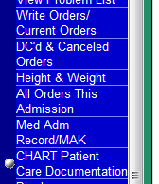
LCR Documentation
Chart Patient Care Documentation
Select Pharmacist Warfarin Education
Document Encounter as DAR
Go to Display Patient Care Documentation to view note and revise or delete

Slide 44
Documentation of Education
Example of Encounter Documentation:
Data: Education required for warfarin.
Action: Spoke to patient regarding indication for warfarin, how to take warfarin, drug and food interactions, monitoring of ADRs. Teaching on warfarin completed with patient. Patient given handout "A patient's guide to warfarin" from JDH Dept of Pharmacy.
Response: Patient confirmed they understood the information provided and left written communication with the patient.

Slide 45
Pharmacist Resources
Daily Warfarin List
American College of Chest Physicians (CHEST Journal)
Pharmacy.uchc.edu Section on Anticoagulation
Inpatient Collaborative Practice Protocol and Forms
Anticoagulation Guideline
Warfarindosing.org - dosing tool
Global RPh – several dose prediction calculators

Slide 46
LET’s PRACTICE!!!!

Slide 47
Sample Case #1 - Day 1
Order for 68 yo male on CS2 with acute decompensated CHF and hx of hypertension:
-Warfarin 2.5mg times one with an indication of atrial fibrillation
-INR target range 2-3
-pharmacist dosed

Slide 48
Sample Case #1 - Day 1
Current Medications:
Metoprolol XL 25mg daily
Furosemide 40mg IV BID
Atorvastatin 20mg daily
Lisinopril 5mg daily

Slide 49
Sample Case #1 - Day 1
INR Goal and indication
Do they match up?
Review to assess dosing considerations:
Notes
Medications
Labs
Determine dose
Document
Counsel

Slide 50
Sample Case #1 - Day 1
Baseline Patient Demographics, Clinical, & Laboratory Data:
Admit Date |  |  | 10/02/2015 |  |  | Age (years) 68 |  | Gender | X M ☐ F
Drug Allergies |  |  | NKDA
Indication |  |  | a fib
Target INR |  |  | X 2 – 3 ☐ 2.5 – 3.5 ☐ Other _________
New Start |  |  | X Yes ☐ No
UCH-Clinic Patient |  |  | ☐ Yes X No
Pre-Admission Dosing/Duration |  |  | n/a
Laboratory Data:
Date ⇨ | 10/2 | 10/3 |  | 10/4
INR | 0.9 | 0.9 |  | 0.9
hgb | 15 | 14 |  | 15
Hct | 42 | 43 |  | 44
PLT | 263 | 233 |  | 242
ALT | 21
AST | 30
Albumin | 3.2
SCr | 1.0 | 1.0 |  | 1.0

Slide 51
Sample Case #1 - Day 1
Warfarin Dosing Considerations: |  |  | X YES | ☐ NO
☐ Concurrent anticoagulant: ___n/a_____________________ ☐ Concurrent antiplatelet: ______n/a__________________ ☐ Potential drug interactions | ☐ Ethnicity X Age ☐ History of falls X Co-morbidity ____CHF___________________ | ☐ Low Albumin ☐ Liver Dysfunction ☐ Renal Dysfunction ☐ Bleeding Risk (Low Hct, PLT)
Additional Comments: | Patient has increased warfarin sensitivity (age greater than 65, CHF)

Slide 52
Initial Dosing for Target INR Goal of 2 -3
Day | Warfarin Starting Dose | INR Value | Warfarin Increased Sensitivity Starting Dose
Day 1 | 5 mg | < 1.5 | 2.5 mg
Day 2 | 5 mg | < 1.5 | 2.5 mg
 | 2.5mg | 1.5 – 1.9 | 1 – 1.5 mg
 | 1 – 2.5 mg | 2 – 2.5 | 0.5 – 1 mg
 | 0 mg | > 2.5 | 0 mg
Day 3 | 5 – 10 mg | < 1.5 | 2.5 – 5 mg
 | 2.5 – 5 mg | 1.5 – 1.9 | 1 – 2.5 mg
 | 0 – 2.5 mg | 2 – 3 | 0 – 1 mg
 | 0 mg | > 3 | 0 mg
Day 4 | 10 mg | < 1.5 | 5 mg
 | 5 – 7.5 mg | 1.5 – 1.9 | 3 – 5 mg
 | 0 – 5 mg | 2 - 3 | 0 – 2.5 mg
 | 0 mg | > 3 | 0 mg
Day 5 | 10 mg | < 1.5 | 5 mg
 | 7.5 – 10 mg | 1.5 – 1.9 | 3 – 5 mg
 | 0 – 5 mg | 2 - 3 | 0 – 2.5 mg
 | 0 mg | > 3 | 0 mg
Day 6 | 7.5 – 12.5 mg | < 1.5 | 3 – 7.5 mg
 | 5 – 10 mg | 1.5 – 1.9 | 2.5 – 5 mg
 | 0 – 7.5 mg | 2 – 3 | 0 – 4 mg
 | 0 mg | > 3 | 0 mg

Slide 53
Sample Case #1 - Day 1
Initial Dose (mg): | 2.5mg | Date of Administration: | 10/4/15
Additional Comments: |  | Patient with increased warfarin sensitivity characteristics. Initiate on 2.5mg. Monitor INR daily.
Date: 10/4/2015 |  | Time: 12:30pm
Pharmacist Name: | A. Pharmacist, PharmD | Signature:
Contact Information: | x7627
Approve order and schedule for 6pm
If order was for 5mg, can adjust to 2.5mg per protocol
If order after consult hours, should be MD dosed first dose then pharmacy takes over during days
Double check INR ordered for next day (and CBC if needed)

Slide 54
Sample Case #1 - Day 1
COUMADIN INDICATION/INR GOAL/DOSE PTA/CLINIC INFO:
WCP, New start a fib, goal 2-3, INR 0.9, CBC and other labs WNL
No DDIs or other anticoagulants. No s/s of bleeding per RN/chart.
Pt with increased warf sensitivity (age, CHF)
10/4 - warfarin 2.5mg
INR scheduled for 10/5
, CBC ok

Slide 55
Sample Case #1 - Day 2
Next day…..
Clinical, & Laboratory Data:
Admit Date |  | 10/2/15 |  |  | Age (years) |  |  | 68 | Gender | X M ☐ F
Indication |  | a fib
Target INR |  | X 2 – 3 ☐ 2.5 – 3.5 ☐ Other _________
Laboratory Data:
Date ⇨ |  |  | 10/3 | 10/4 |  | 10/5
INR: |  |  | 0.9 | 0.9 |  | 1.6
Signs or Symptoms of Bleeding Noted: |  |  | ☐ YES | X NO
Changes in Warfarin Dosing Considerations: |  |  | ☐ YES | X NO
☐ Concurrent anticoagulant: ________________________ ☐ Concurrent antiplatelet: ________________________ ☐ Potential drug interactions |  | ☐ Low Albumin ☐ Liver Dysfunction ☐ Renal Dysfunction ☐ Bleeding Risk (Low HCT, PLT)
Additional Comments: | Pt with increased warfarin sensitivity (age, CHF)

Slide 56
Initial Dosing for Target INR Goal of 2 -3
Day | Warfarin Starting Dose | INR Value | Warfarin Increased Sensitivity Starting Dose
Day 1 | 5 mg | < 1.5 | 2.5 mg
Day 2 | 5 mg | < 1.5 | 2.5 mg
 | 2.5mg | 1.5 – 1.9 | 1 – 1.5 mg
 | 1 – 2.5 mg | 2 – 2.5 | 0.5 – 1 mg
 | 0 mg | > 2.5 | 0 mg
Day 3 | 5 – 10 mg | < 1.5 | 2.5 – 5 mg
 | 2.5 – 5 mg | 1.5 – 1.9 | 1 – 2.5 mg
 | 0 – 2.5 mg | 2 – 3 | 0 – 1 mg
 | 0 mg | > 3 | 0 mg
Day 4 | 10 mg | < 1.5 | 5 mg
 | 5 – 7.5 mg | 1.5 – 1.9 | 3 – 5 mg
 | 0 – 5 mg | 2 - 3 | 0 – 2.5 mg
 | 0 mg | > 3 | 0 mg
Day 5 | 10 mg | < 1.5 | 5 mg
 | 7.5 – 10 mg | 1.5 – 1.9 | 3 – 5 mg
 | 0 – 5 mg | 2 - 3 | 0 – 2.5 mg
 | 0 mg | > 3 | 0 mg
Day 6 | 7.5 – 12.5 mg | < 1.5 | 3 – 7.5 mg
 | 5 – 10 mg | 1.5 – 1.9 | 2.5 – 5 mg
 | 0 – 7.5 mg | 2 – 3 | 0 – 4 mg
 | 0 mg | > 3 | 0 mg

Slide 57
Sample Case #1 - Day 2
Documentation
Chart
Siemens®
DON’T FORGET TO ORDER THE DOSE!
And labs if needed
Counseling done?

Slide 58
Sample Case #2
Pt is 58 yo F from SNF for tx of PNA on MED4
PTA warfarin 6mg daily for recurrent DVT
Current medications: levofloxacin IV (new), docusate sodium po (new), famotidine po (new), sodium chloride IV (new), lisinopril (pta), citalopram (pta), memantine (pta)
The provider has ordered WCP with a target of 2-3 with and indication of DVT

Slide 59
Sample Case #2
Baseline Patient Demographics, Clinical, & Laboratory Data:
Admit Date |  |  | 10/02/2015 |  |  | Age (years) 58 |  | Gender | ☐ M XF
Drug Allergies |  |  | NKDA
Indication |  |  | recurrent DVT
Target INR |  |  | X 2 – 3 ☐ 2.5 – 3.5 ☐ Other _________
New Start |  |  | ☐Yes X No
UCH-Clinic Patient |  |  | ☐ Yes X No
Pre-Admission Dosing/Duration |  |  | 6mg daily, per SNF (started in April 2013 per cardio note)
Laboratory Data:
Date ⇨ | 10/4
INR | 1.7
hgb | 15
Hct | 42
PLT | 263
ALT | 21
AST | 30
Albumin | 3.2
SCr | 0.8

Slide 60
Sample Case #2
Warfarin Dosing Considerations: |  |  | X YES | ☐ NO
☐ Concurrent anticoagulant: ___n/a_____________________ ☐ Concurrent antiplatelet: ______n/a__________________ X Potential drug interactions Citalopram and levofloxacin | ☐ Ethnicity ☐ Age ☐ History of falls ☐ Co-morbidity ______________________ | ☐ Low Albumin ☐ Liver Dysfunction ☐ Renal Dysfunction ☐ Bleeding Risk (Low Hct, PLT)
Additional Comments: | Patient started on levofloxacin, which may increase INR/bleeding risk. Patient stable on citalopram PTA.

Slide 61
Continuation of Therapy: Warfarin Maintenance Dosing
Target INR 2 - 3 | Dosing Adjustment | Target INR 2.5-3.5
INR < 1.5 | consider booster dose of 1.5-2 times daily maintenance dose consider resumption of prior maintenance dose if factor causing decreased INR is transient, (i.e. missed warfarin doses) if dosage adjustment is needed increase maintenance dose by 10-20% | INR < 2
INR 1.5 - 1.7 | consider booster dose of 1.5-2 times daily maintenance dose consider resumption of prior maintenance dose if factor causing decreased INR is transient, (i.e. missed warfarin doses) if dosage adjustment is needed, increase maintenance dose by 5-15% | INR 2-2.3
INR 1.8 - 1.9 | no dosage adjustment may be necessary: if the last two INR’s were in range, if there is no clear explanation for the INR to be out of range and if in the judgment of the clinician the INR does not represent an increased risk of thromboembolism for the patient consider booster dose of 1.5-2 times daily maintenance dose consider resumption of prior maintenance dose if factor causing decreased INR is transient, (i.e. missed warfarin doses) if dosage adjustment is needed, increase maintenance dose by 5-10% | INR 2.3-2.4

Slide 62
Sample Case #2
Initial Dose (mg): | 7mg | Date of Administration: | 10/4/15
Additional Comments: |  | INR 1.7 today. On 6mg daily PTA. Levofloxacin started today, which may increase INR. Will monitor INR daily.
Date: 10/4/2015 |  | Time: 12:30pm
Pharmacist Name: | A. Pharmacist, PharmD | Signature:
Contact Information: | x7627
Approve order and schedule for 6pm
Double check INR ordered for next day (and CBC if needed)
Make sure order is in CPOE
Complete Documentation
Counseling?

Slide 63
Questions?

